Slide 1
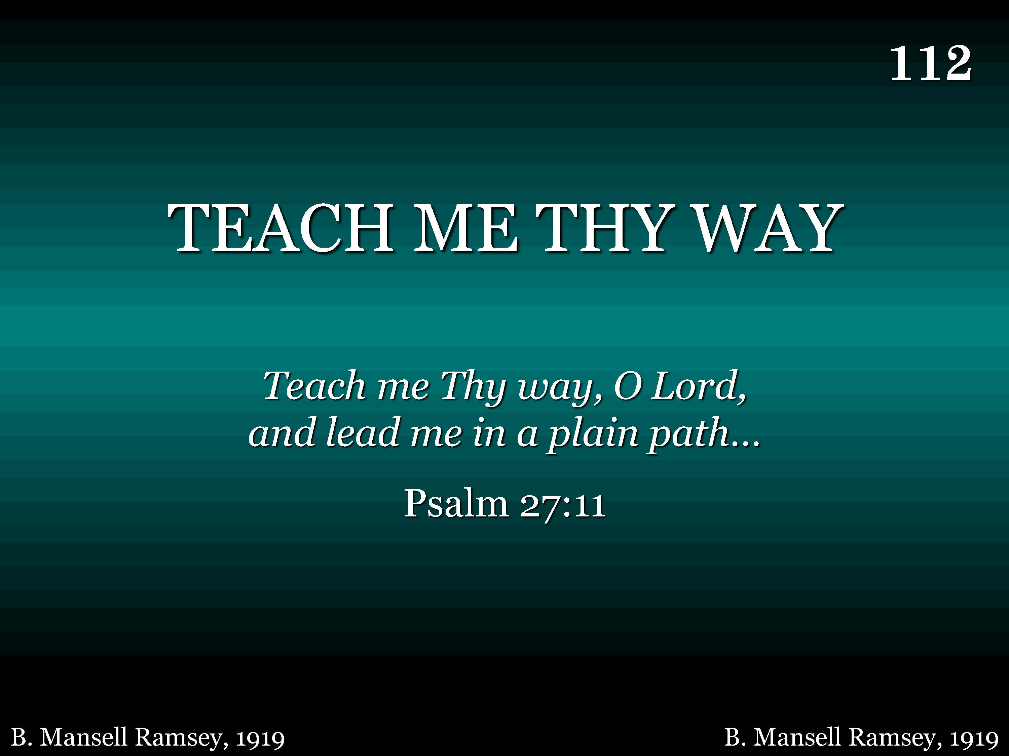
112 - Teach Me Thy Way - Title

Slide 2
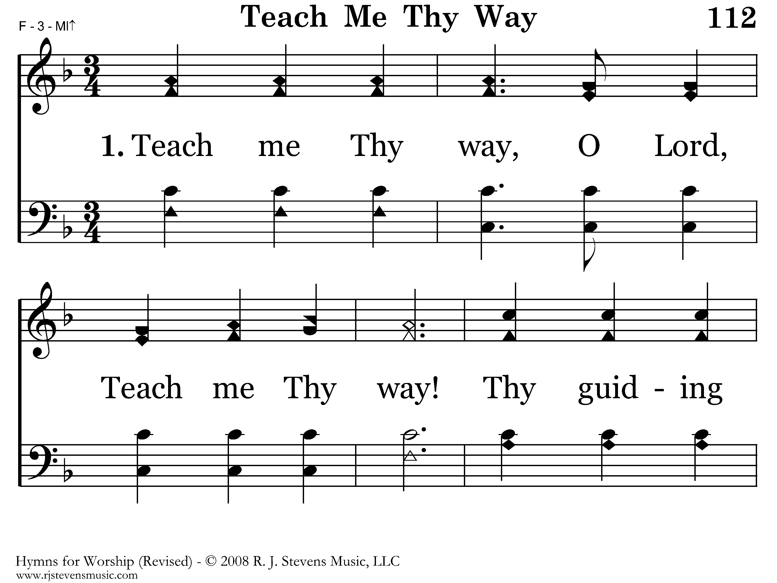
112 - Teach Me Thy Way - 1.1

Slide 3
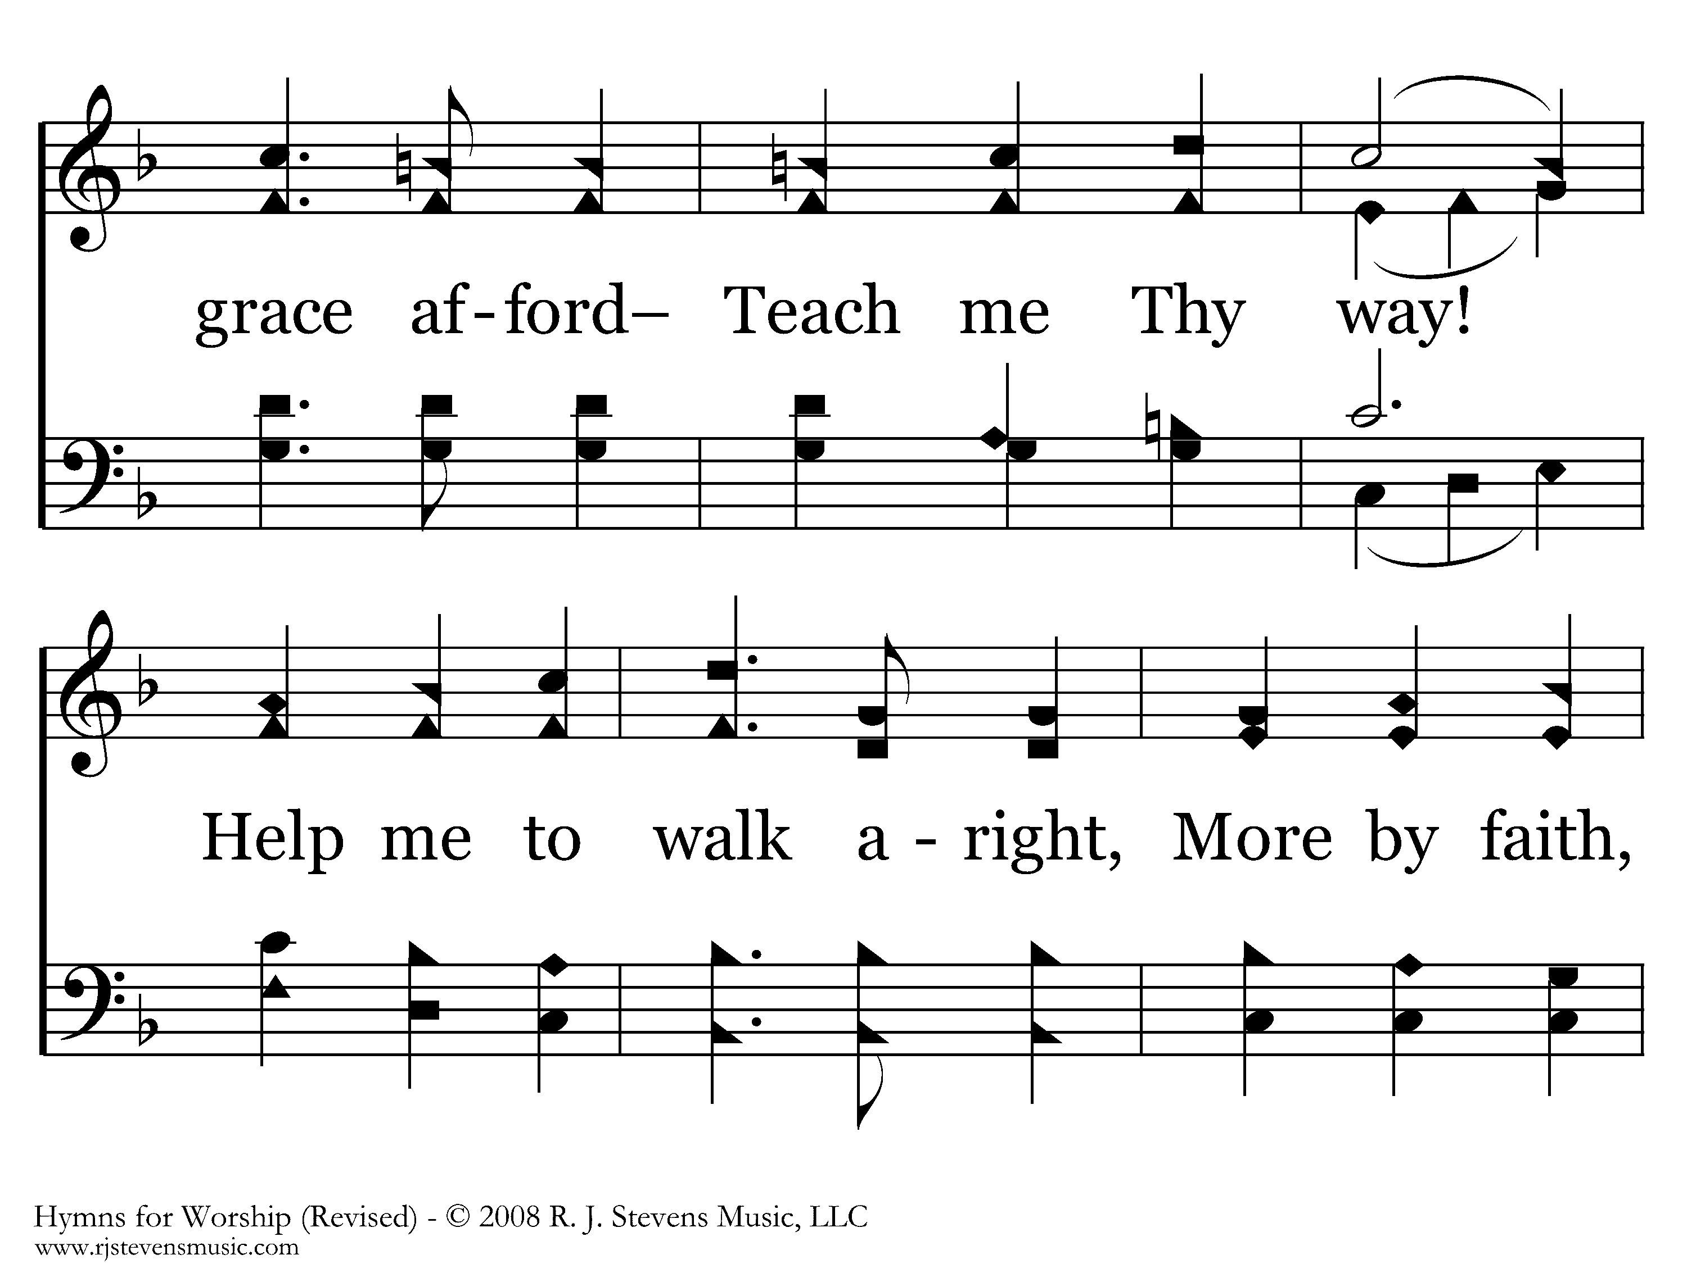
112 - Teach Me Thy Way - 1.2

Slide 4
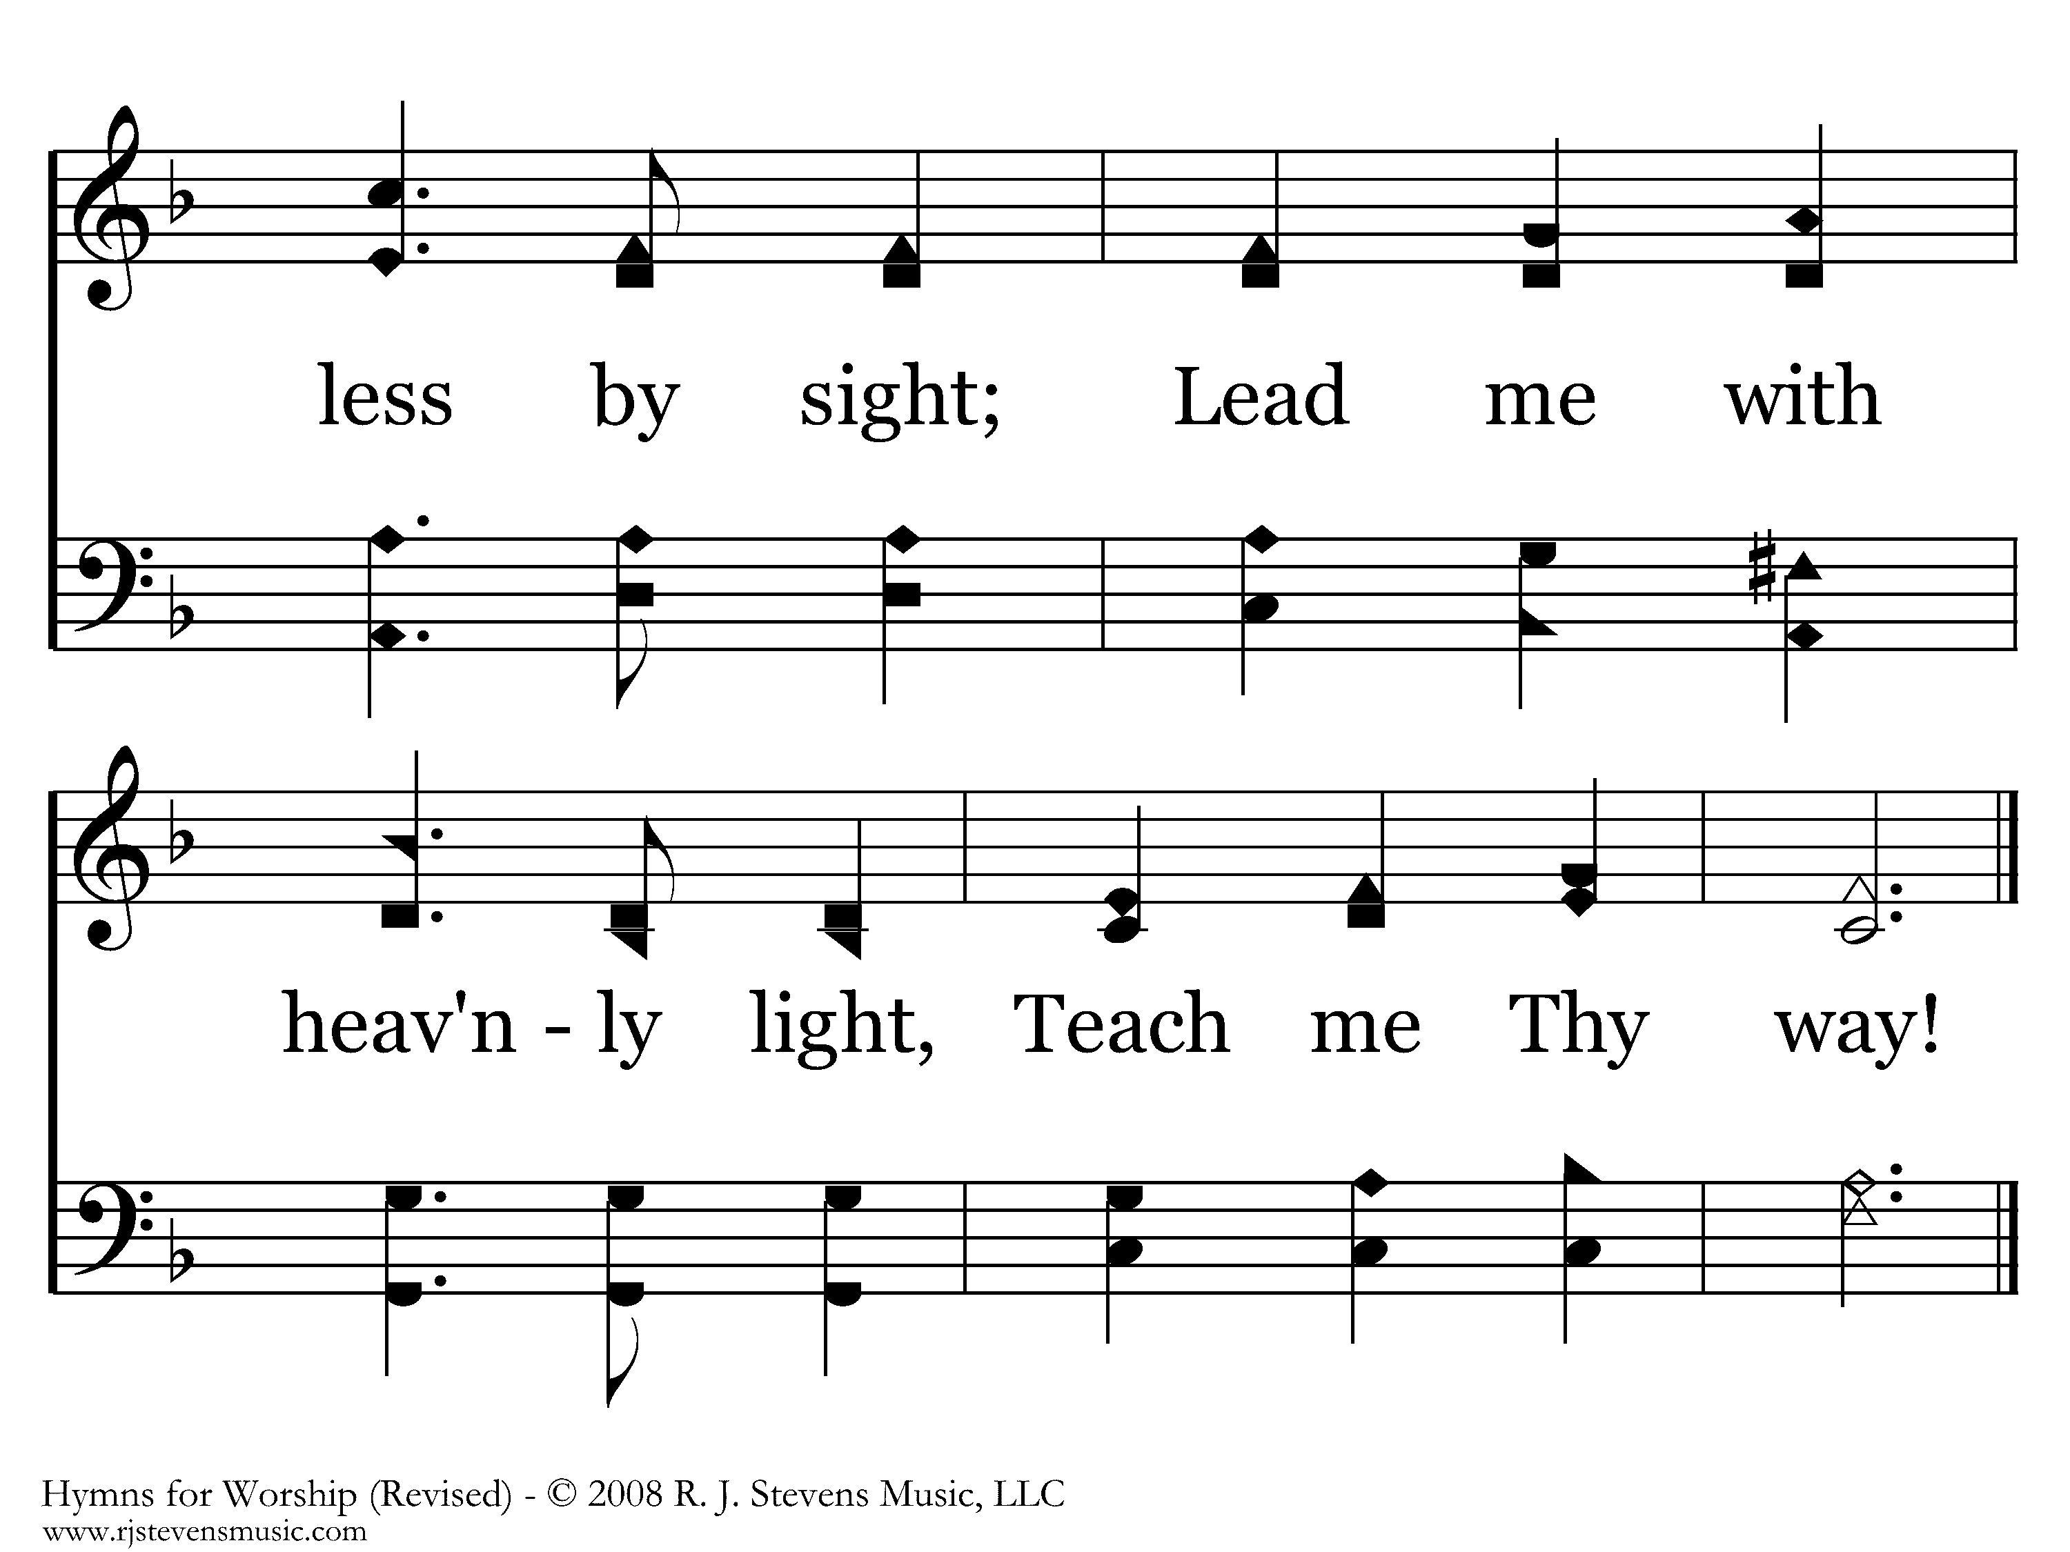
112 - Teach Me Thy Way - 1.3
End of Verse 1

Slide 5
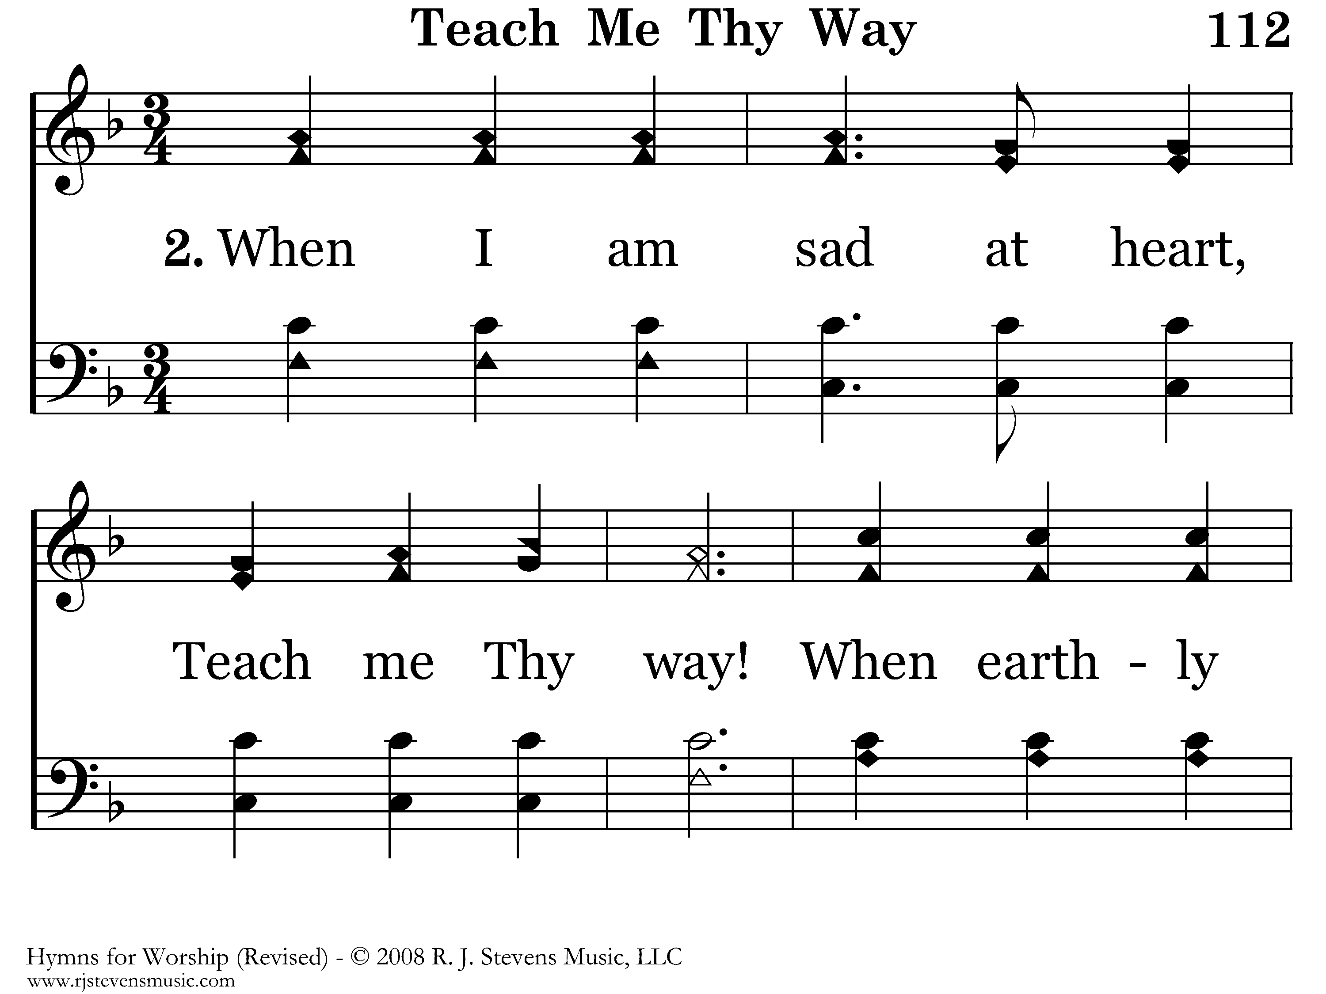
112 - Teach Me Thy Way - 2.1

Slide 6
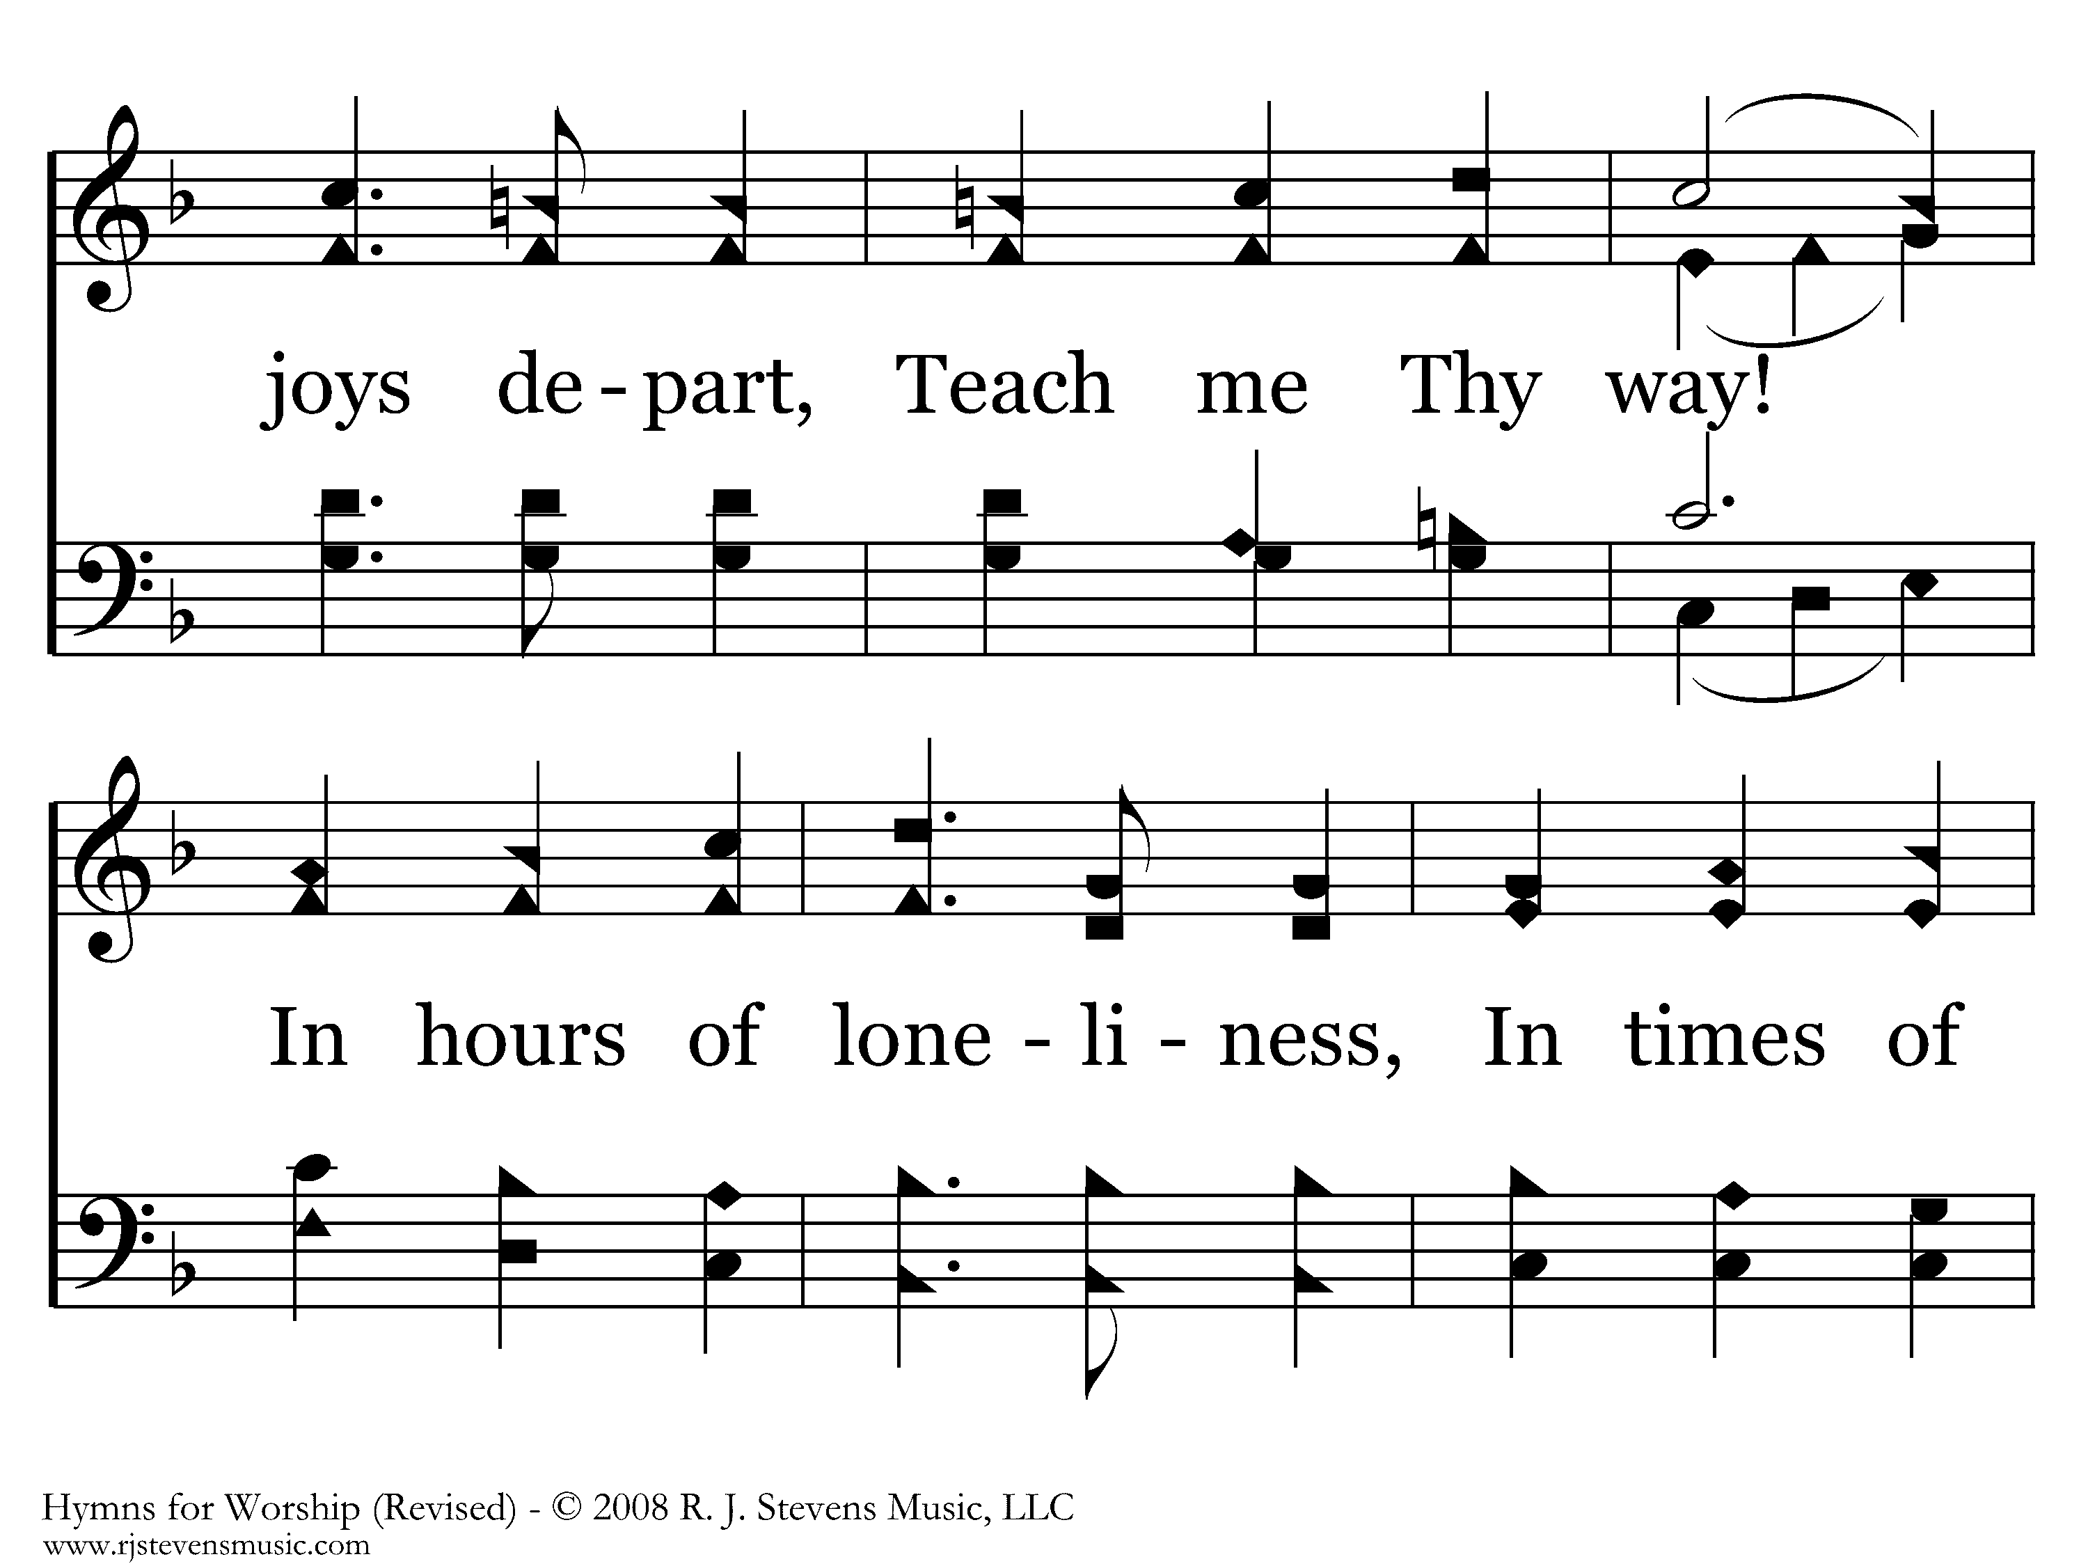
112 - Teach Me Thy Way - 2.2

Slide 7
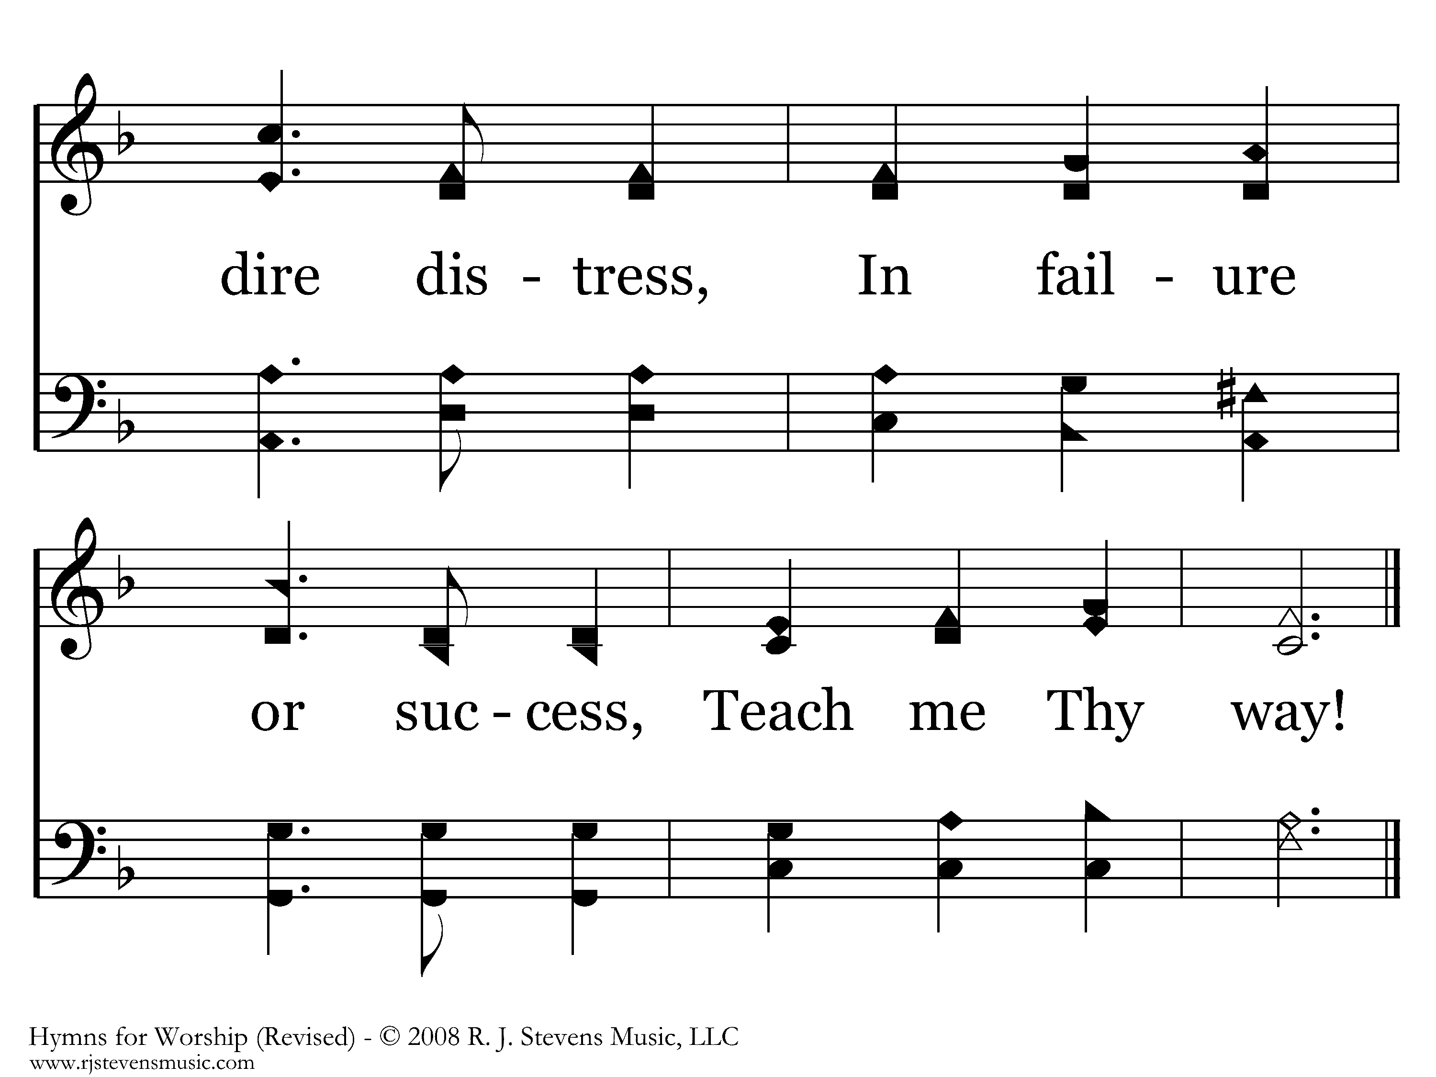
112 - Teach Me Thy Way - 2.3
End of Verse 2

Slide 8
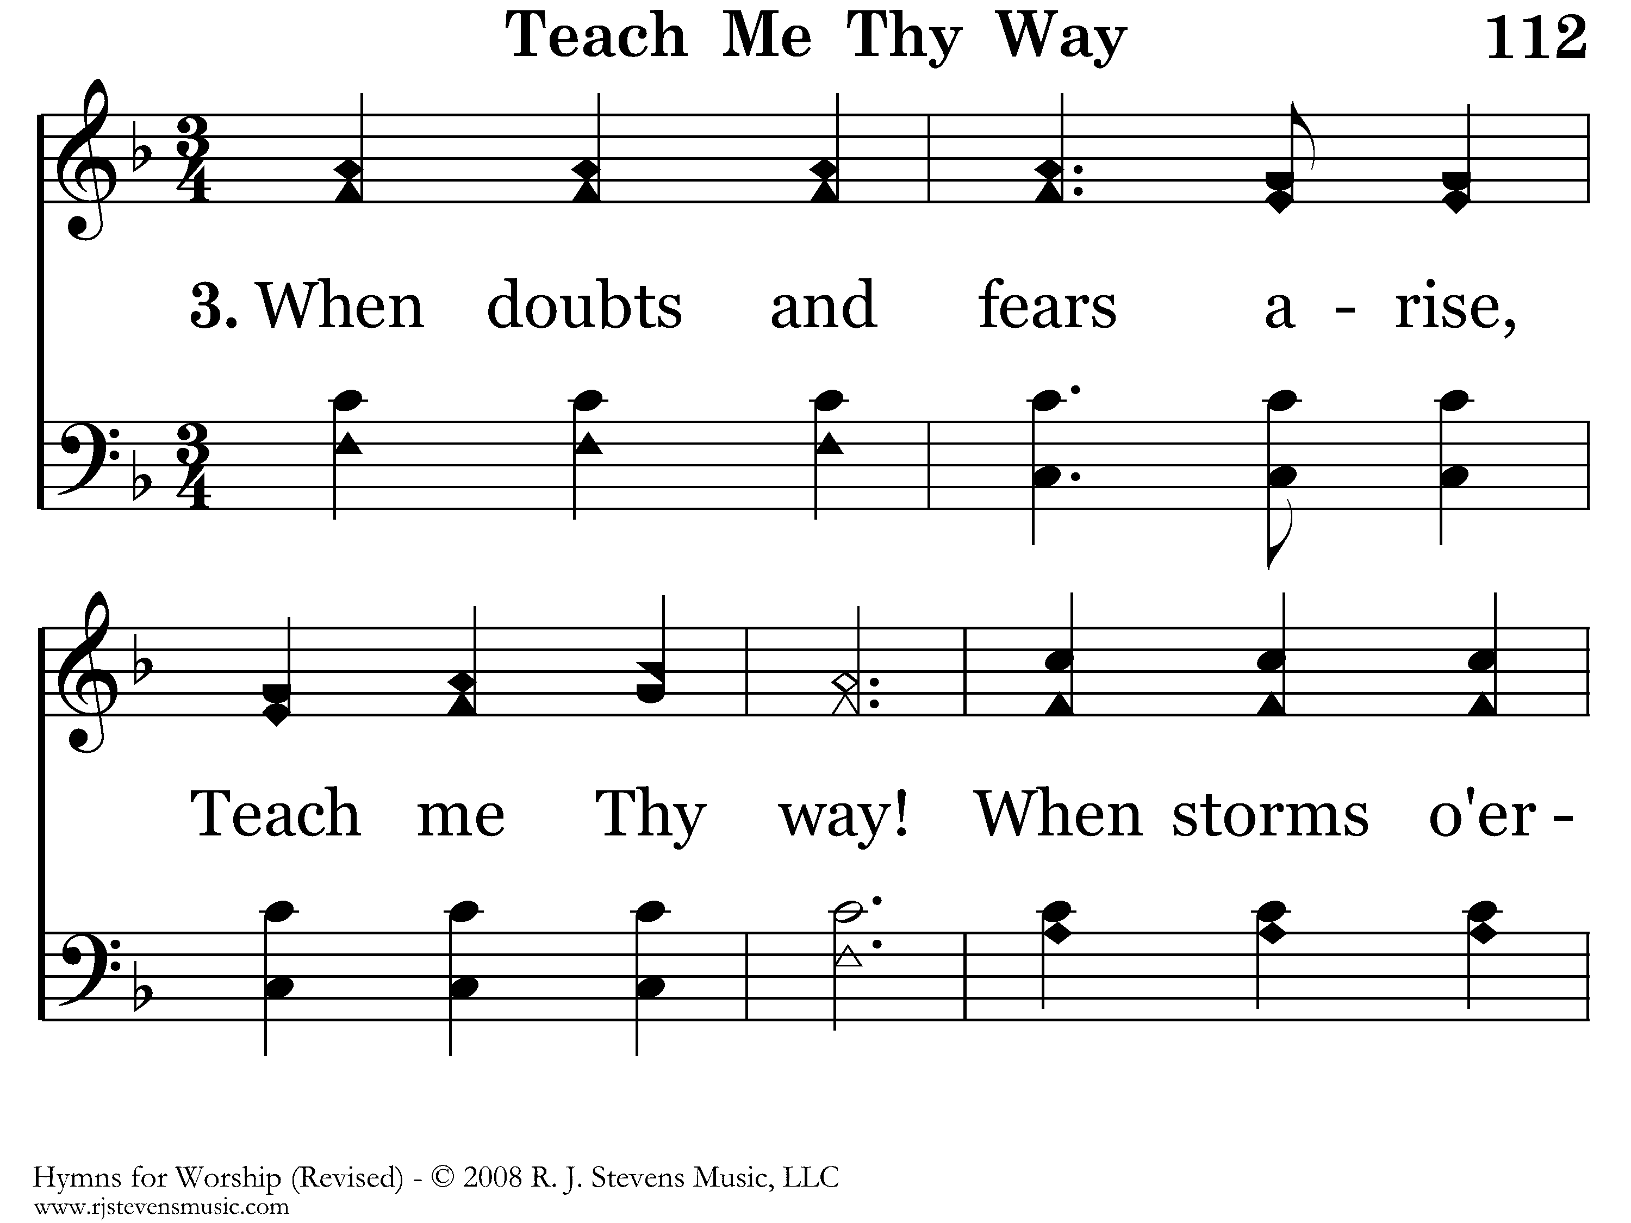
112 - Teach Me Thy Way - 3.1

Slide 9
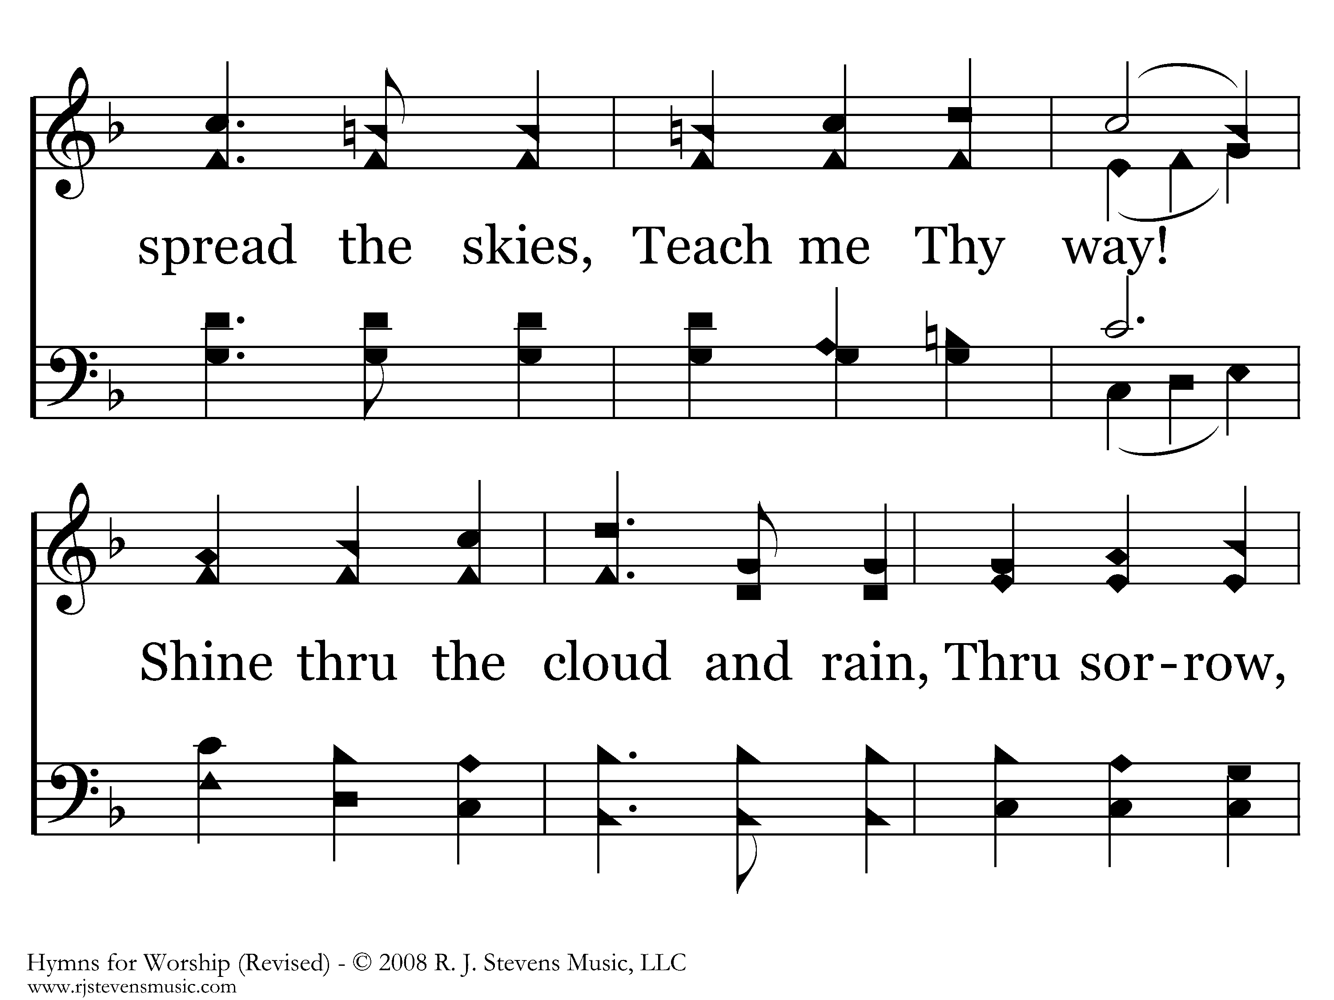
112 - Teach Me Thy Way - 3.2

Slide 10
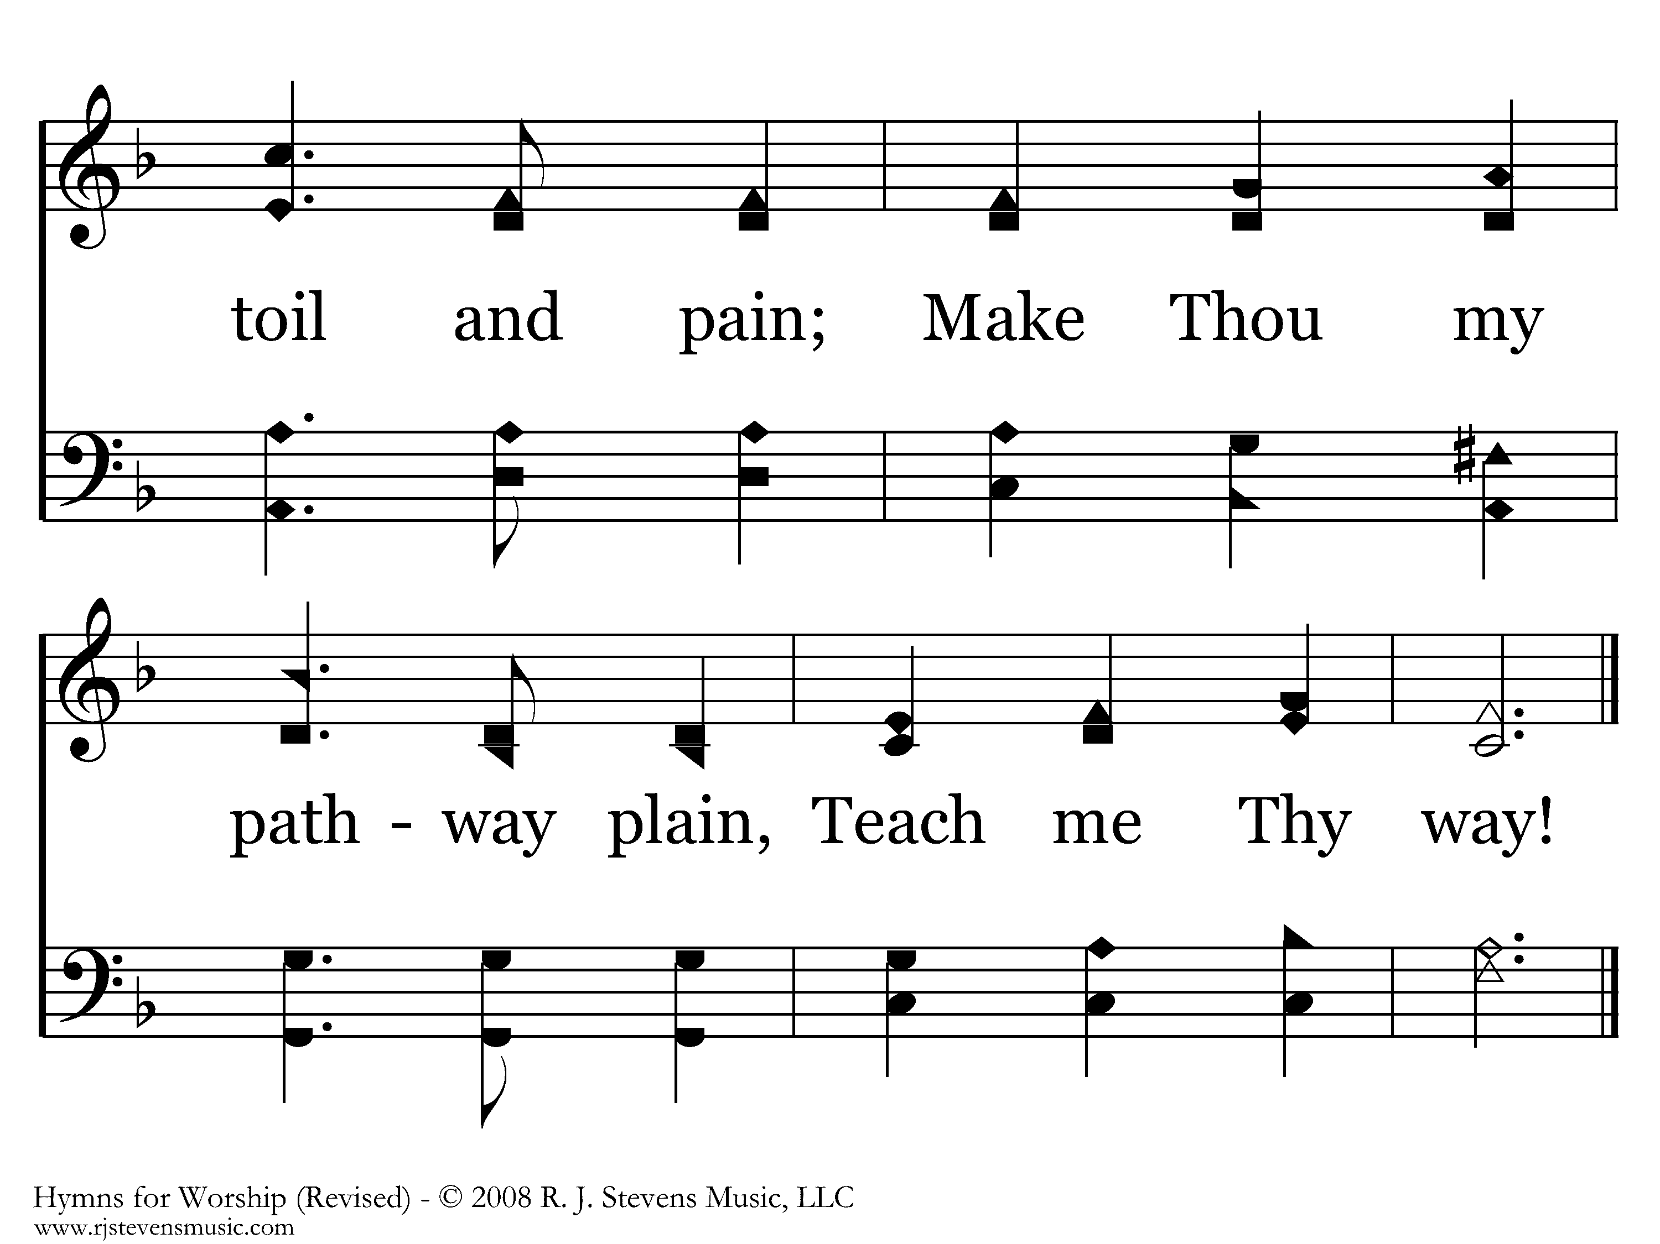
112 - Teach Me Thy Way - 3.3
End of Verse 3

Slide 11

112 - Teach Me Thy Way - 4.1

Slide 12
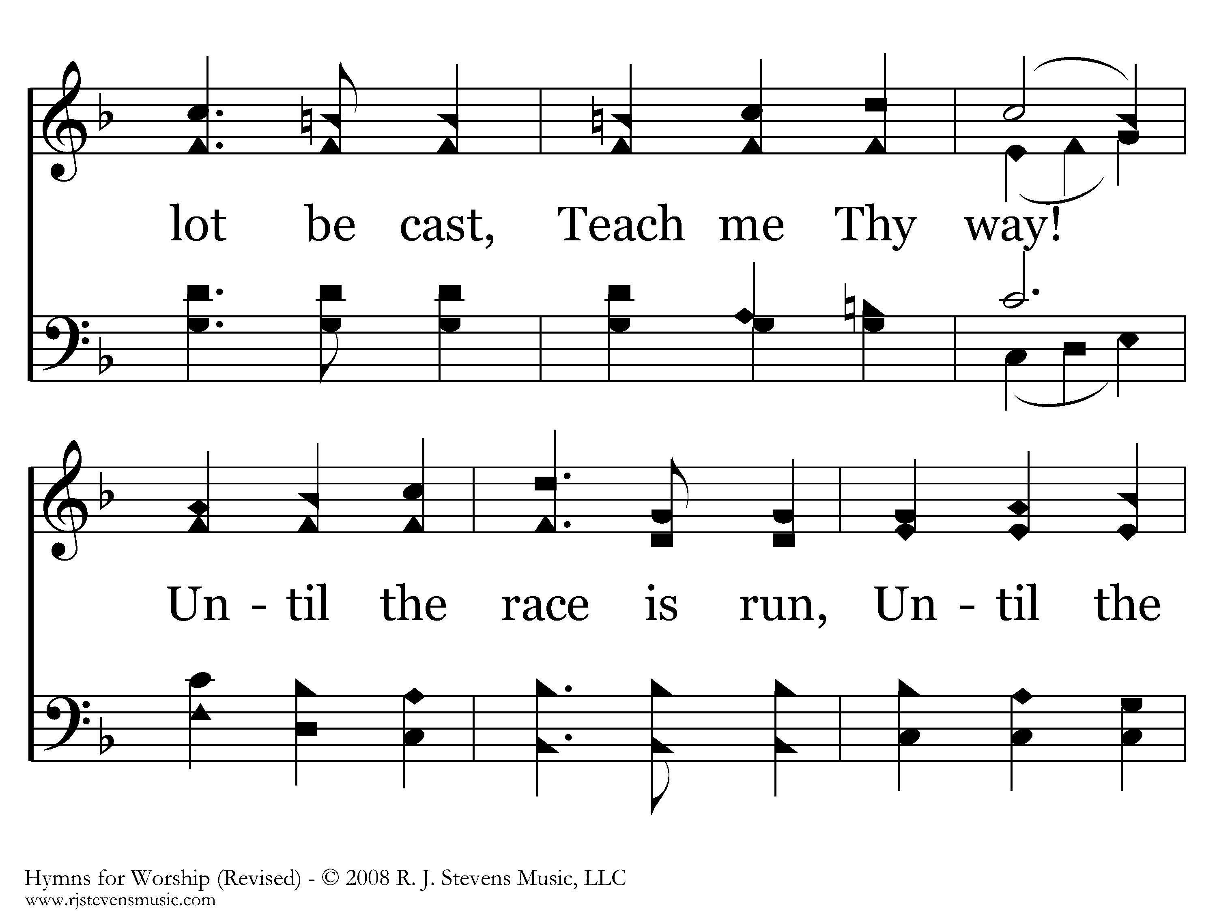
112 - Teach Me Thy Way - 4.2

Slide 13
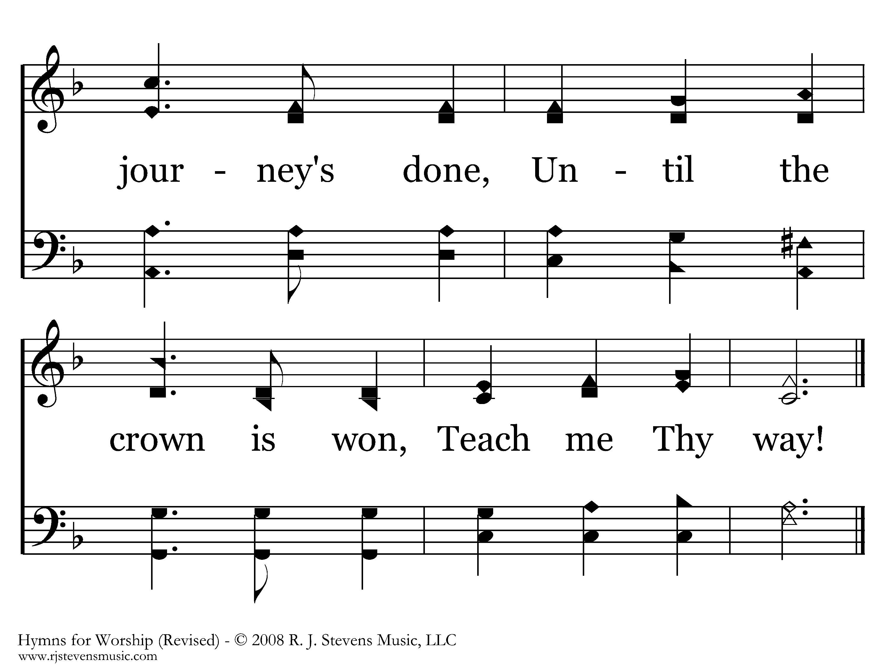
112 - Teach Me Thy Way - 4.3
End of Song

Slide 14
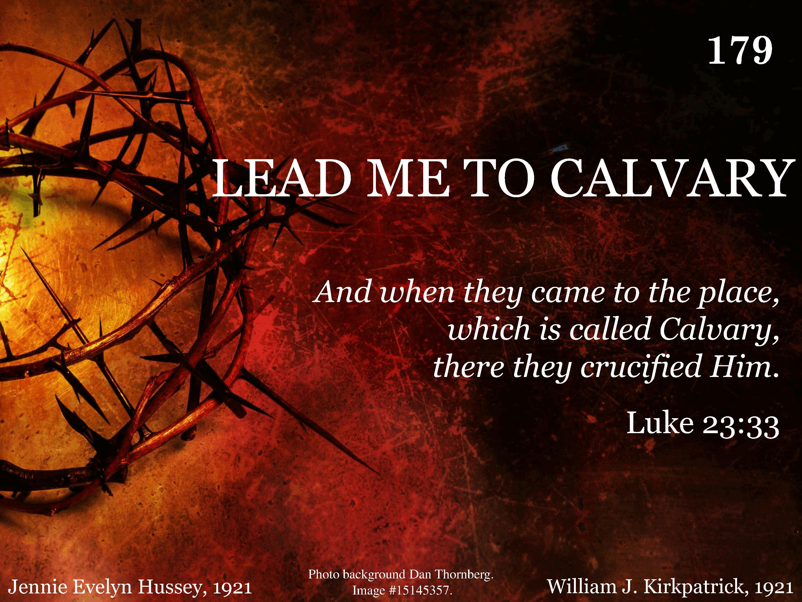
179 - Lead Me To Calvary - Title

Slide 15
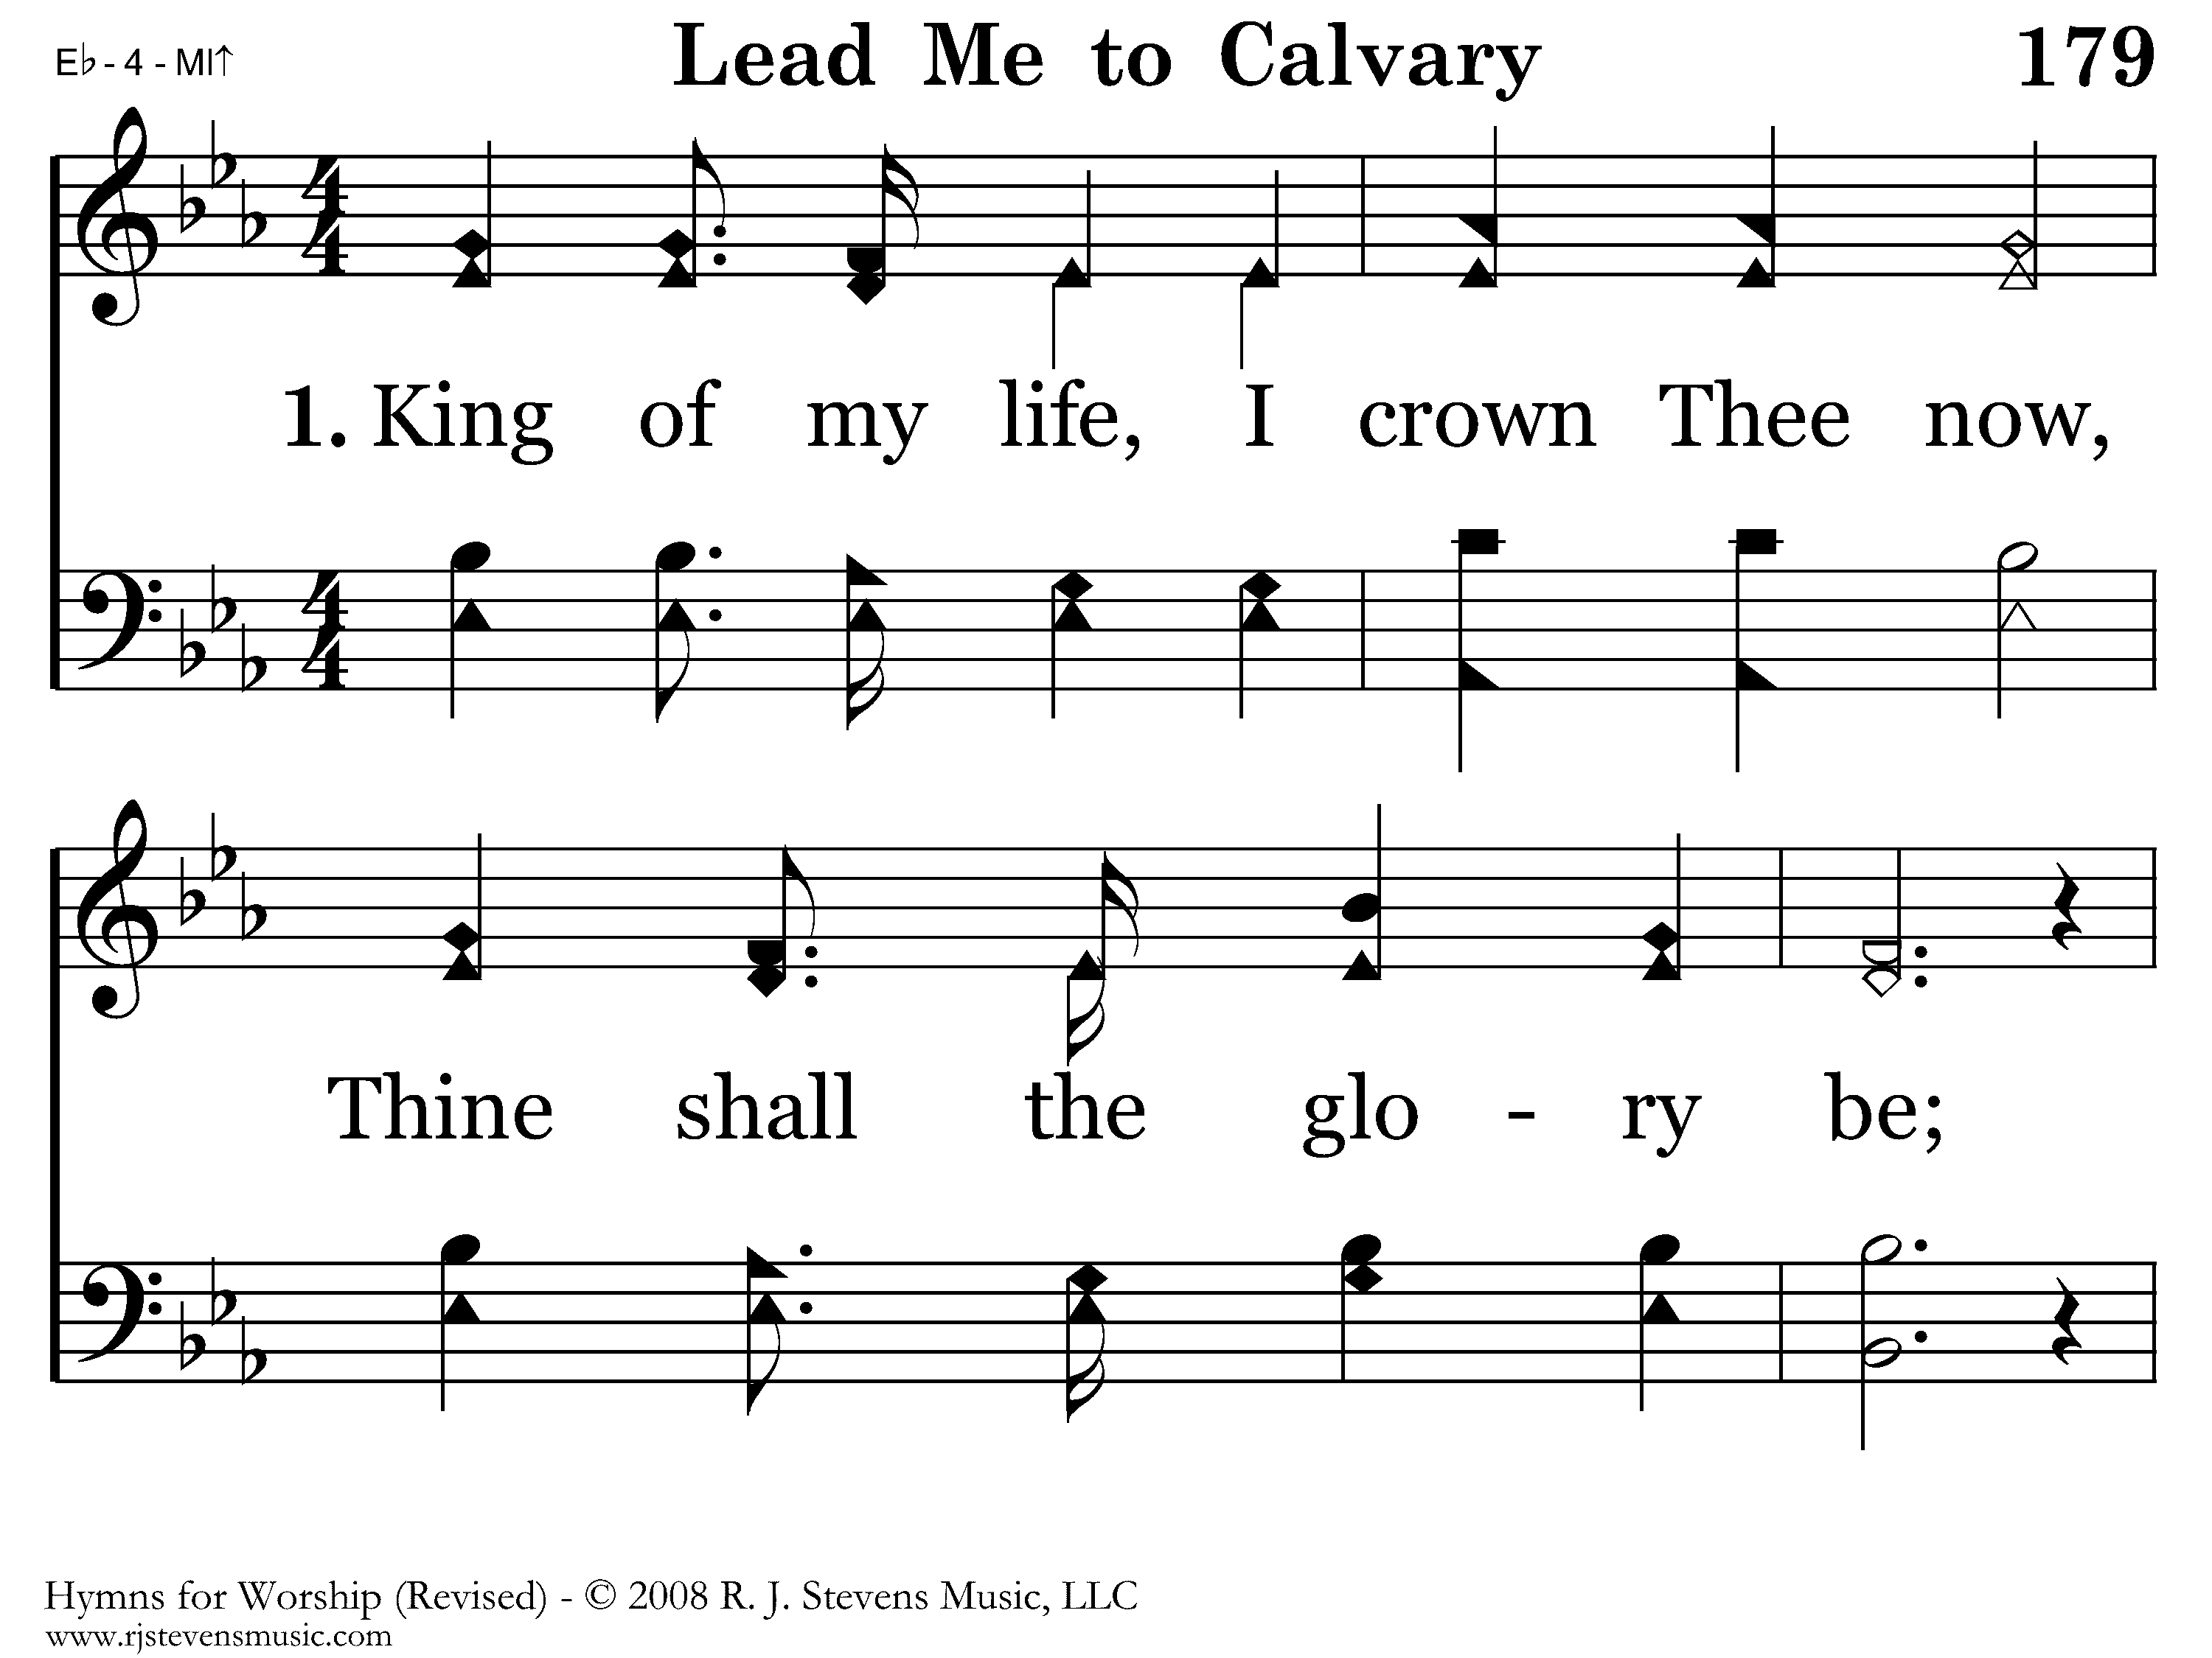
179 - Lead Me To Calvary - 1.1

Slide 16
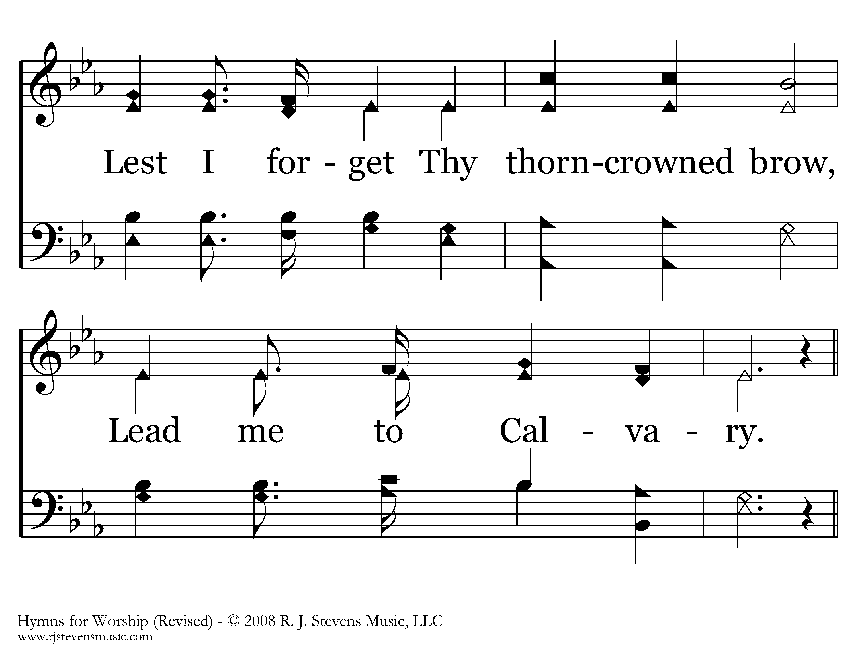
179 - Lead Me To Calvary - 1.2

Slide 17
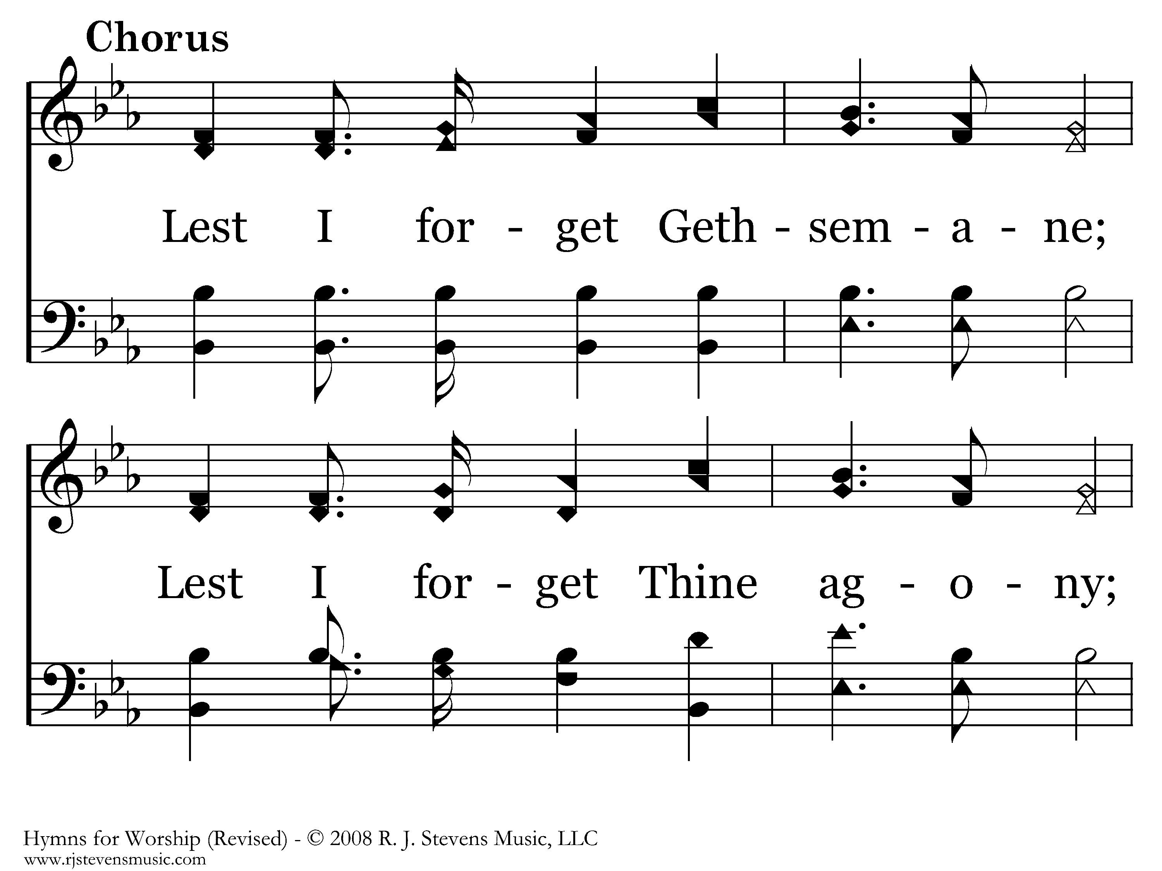
179 - Lead Me To Calvary - C.1

Slide 18
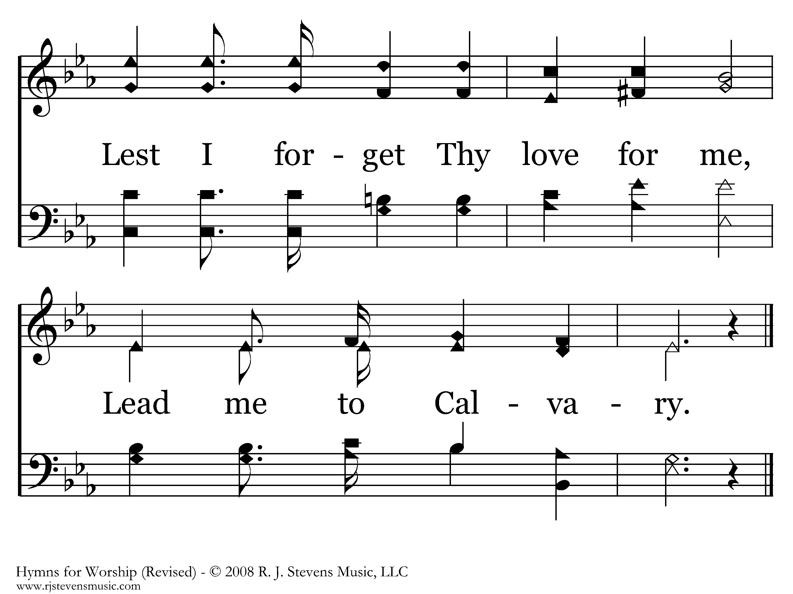
179 - Lead Me To Calvary - C.2
End of Verse 1

Slide 19
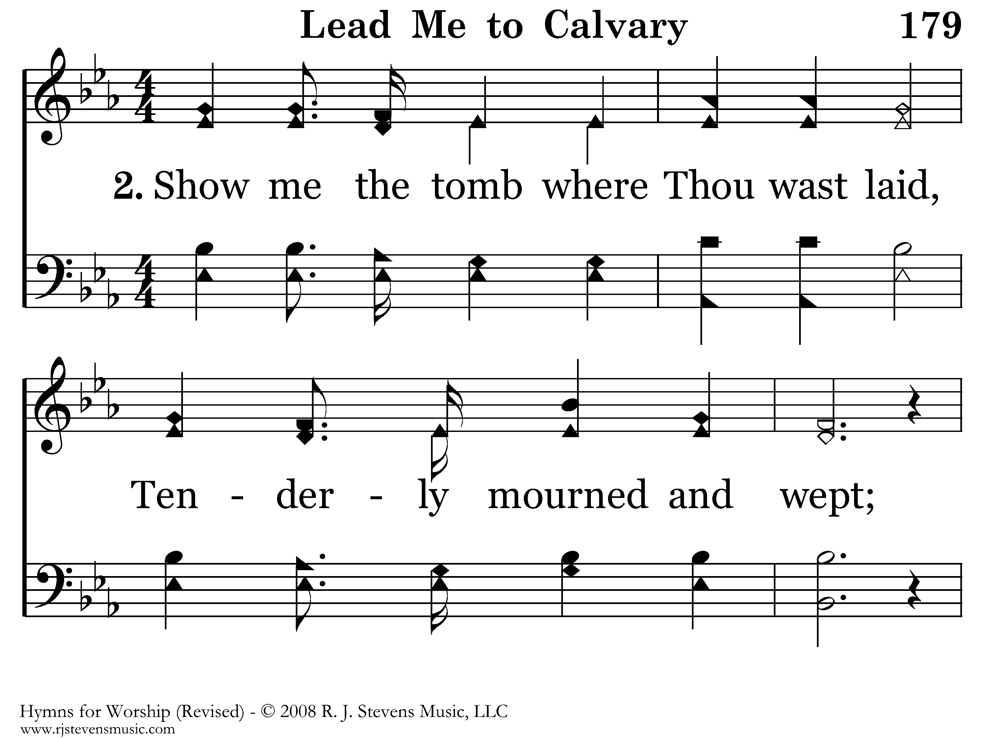
179 - Lead Me To Calvary - 2.1

Slide 20
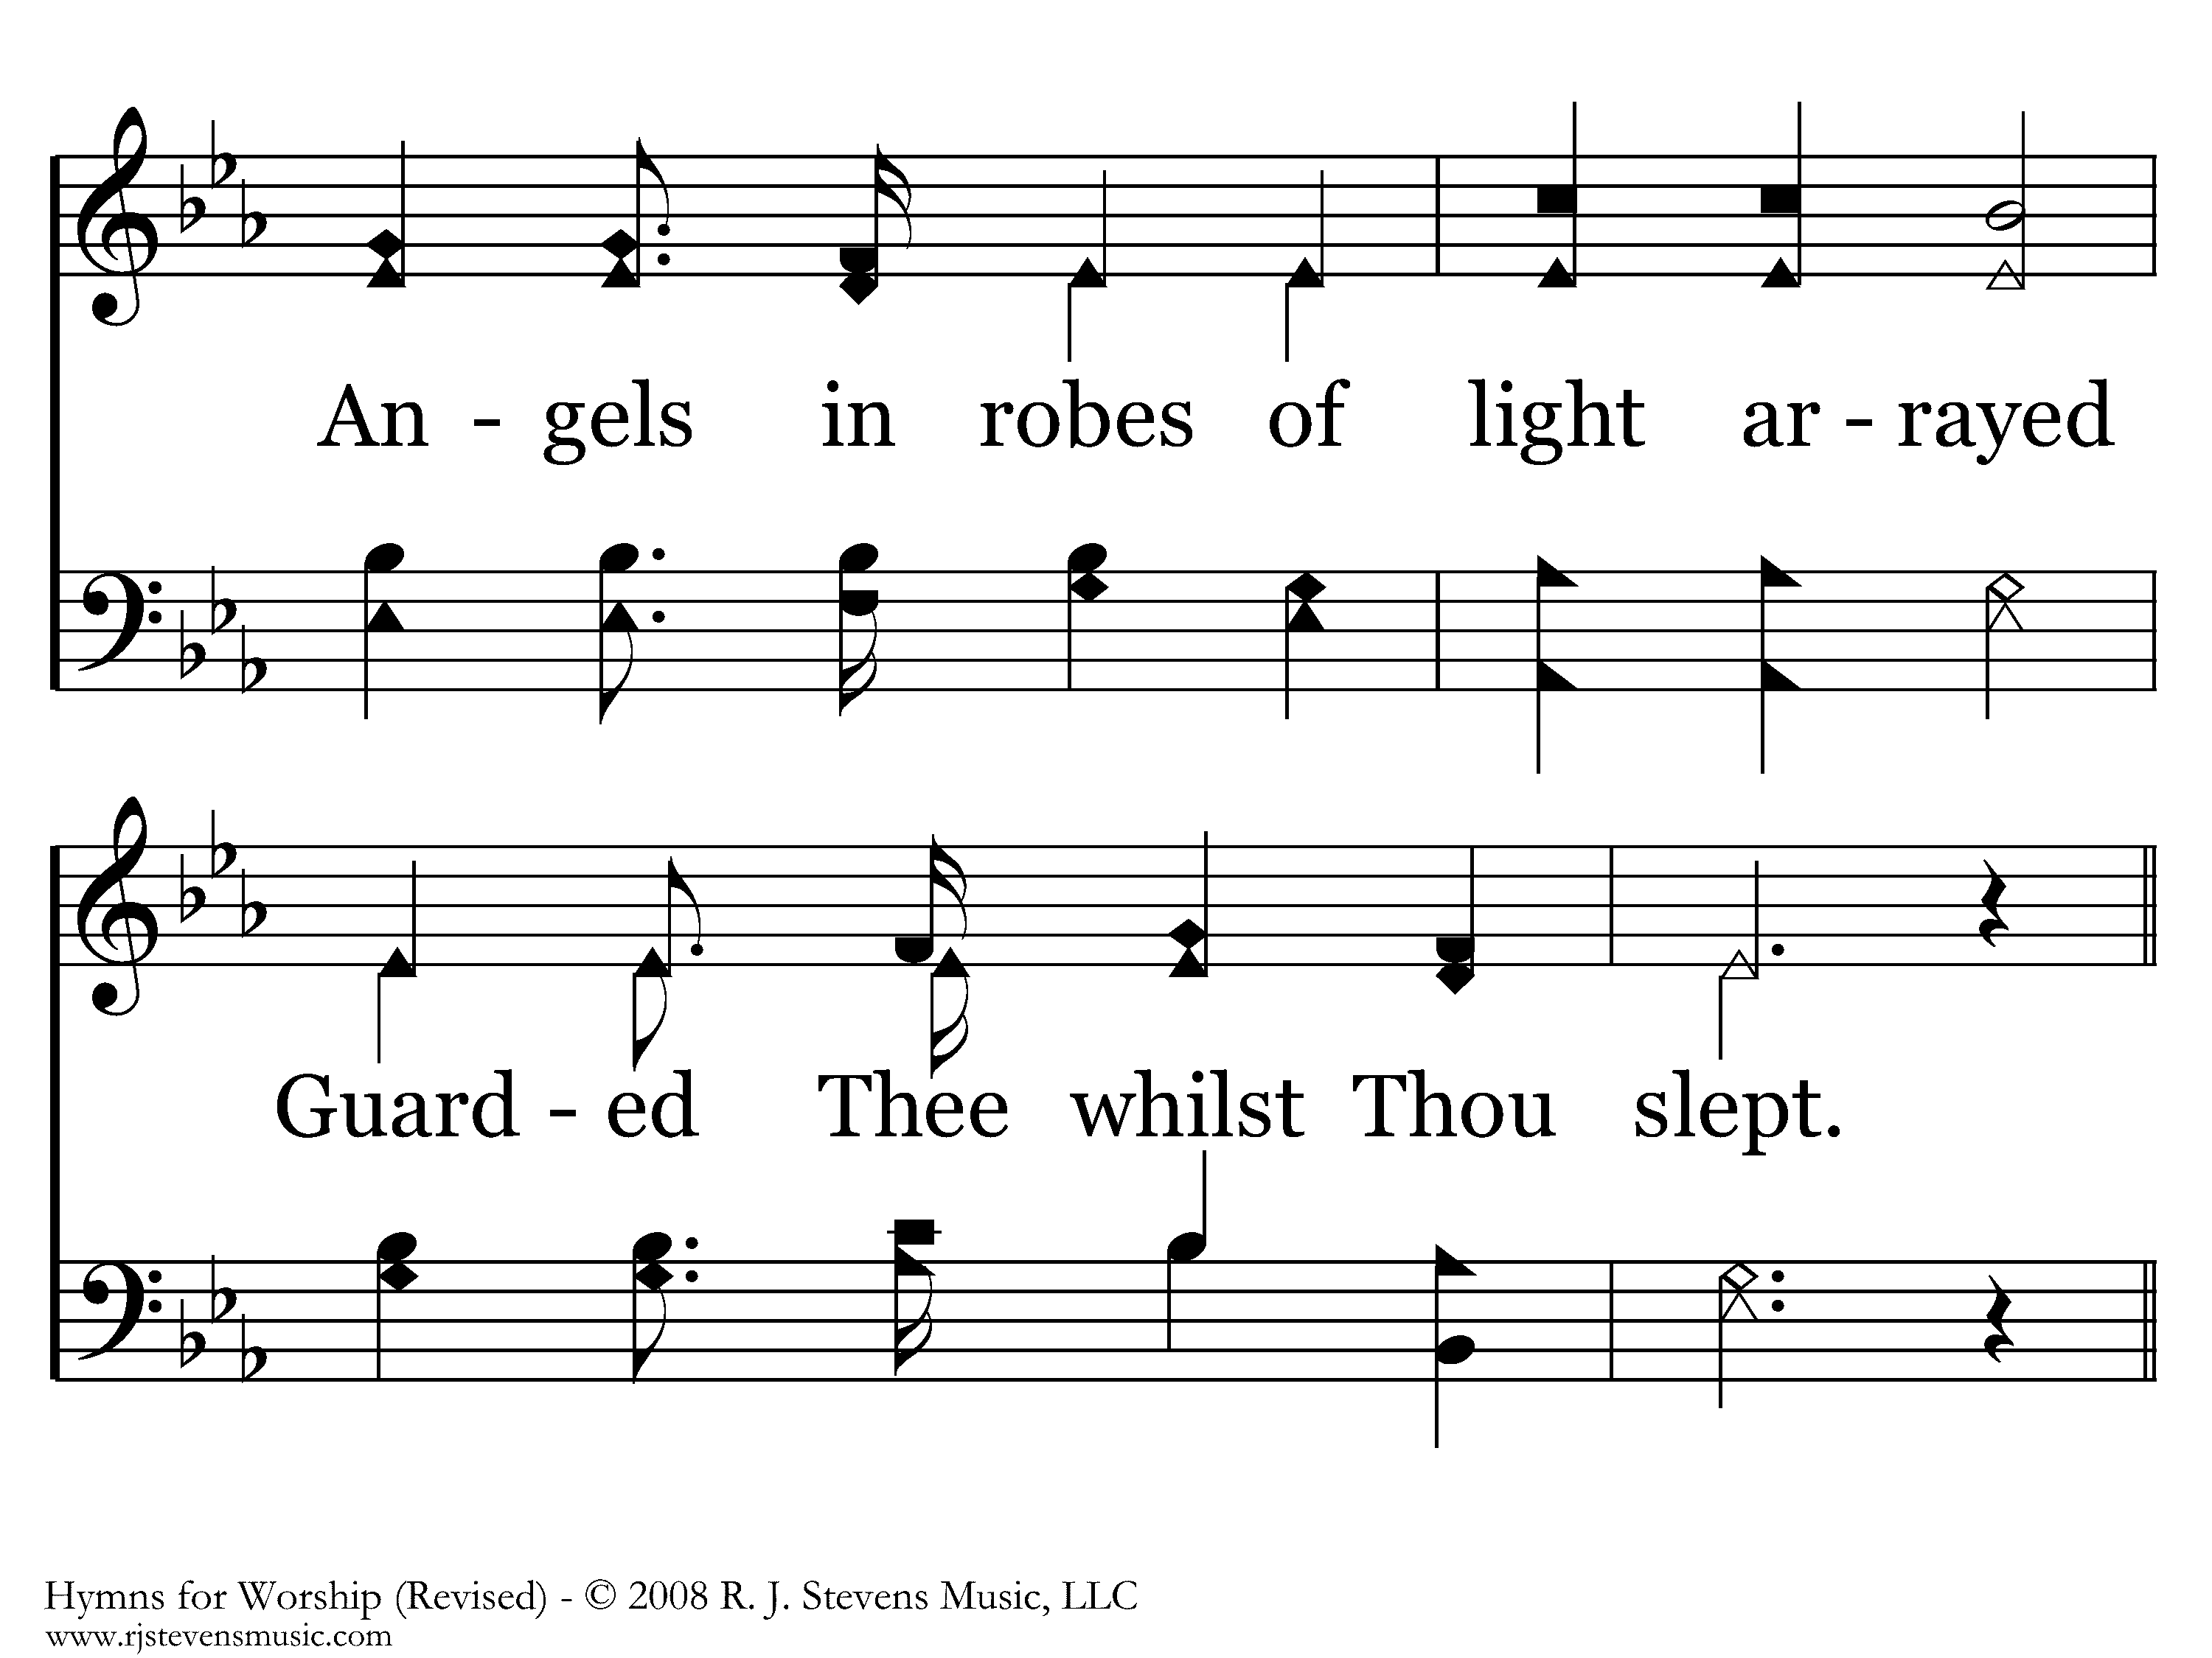
179 - Lead Me To Calvary - 2.2

Slide 21
179 - Lead Me To Calvary - C.1

Slide 22
179 - Lead Me To Calvary - C.2
End of Verse 2

Slide 23
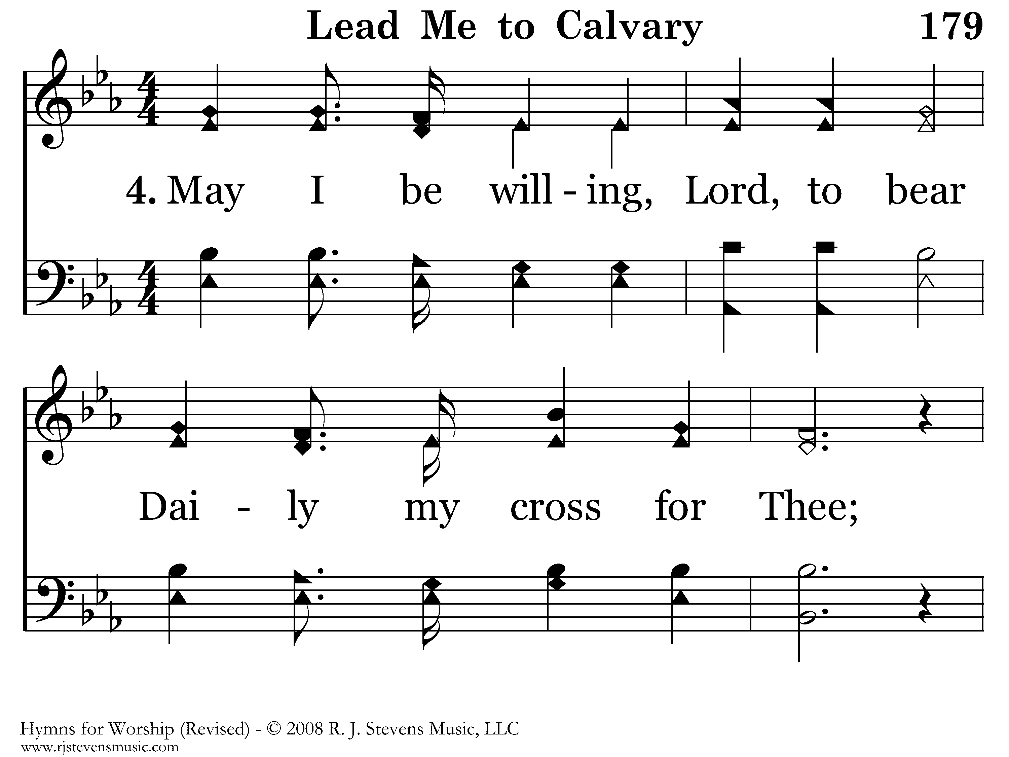
179 - Lead Me To Calvary - 4.1

Slide 24
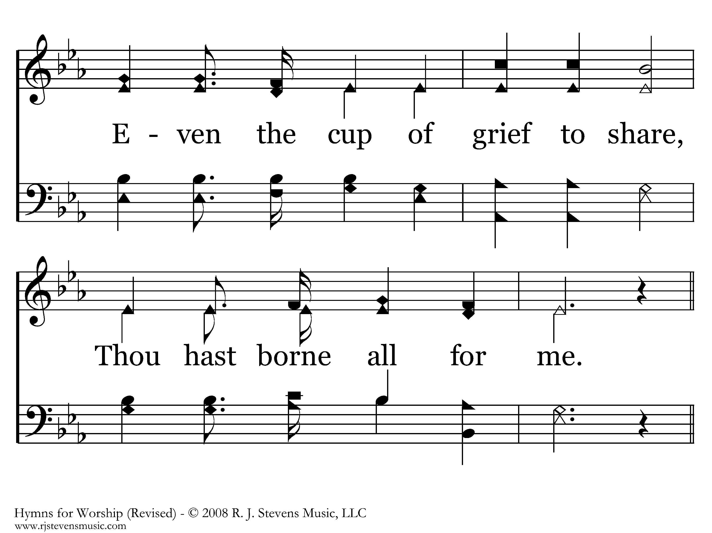
179 - Lead Me To Calvary - 4.2

Slide 25
179 - Lead Me To Calvary - C.1

Slide 26
179 - Lead Me To Calvary - C.2
End of Song

Slide 27
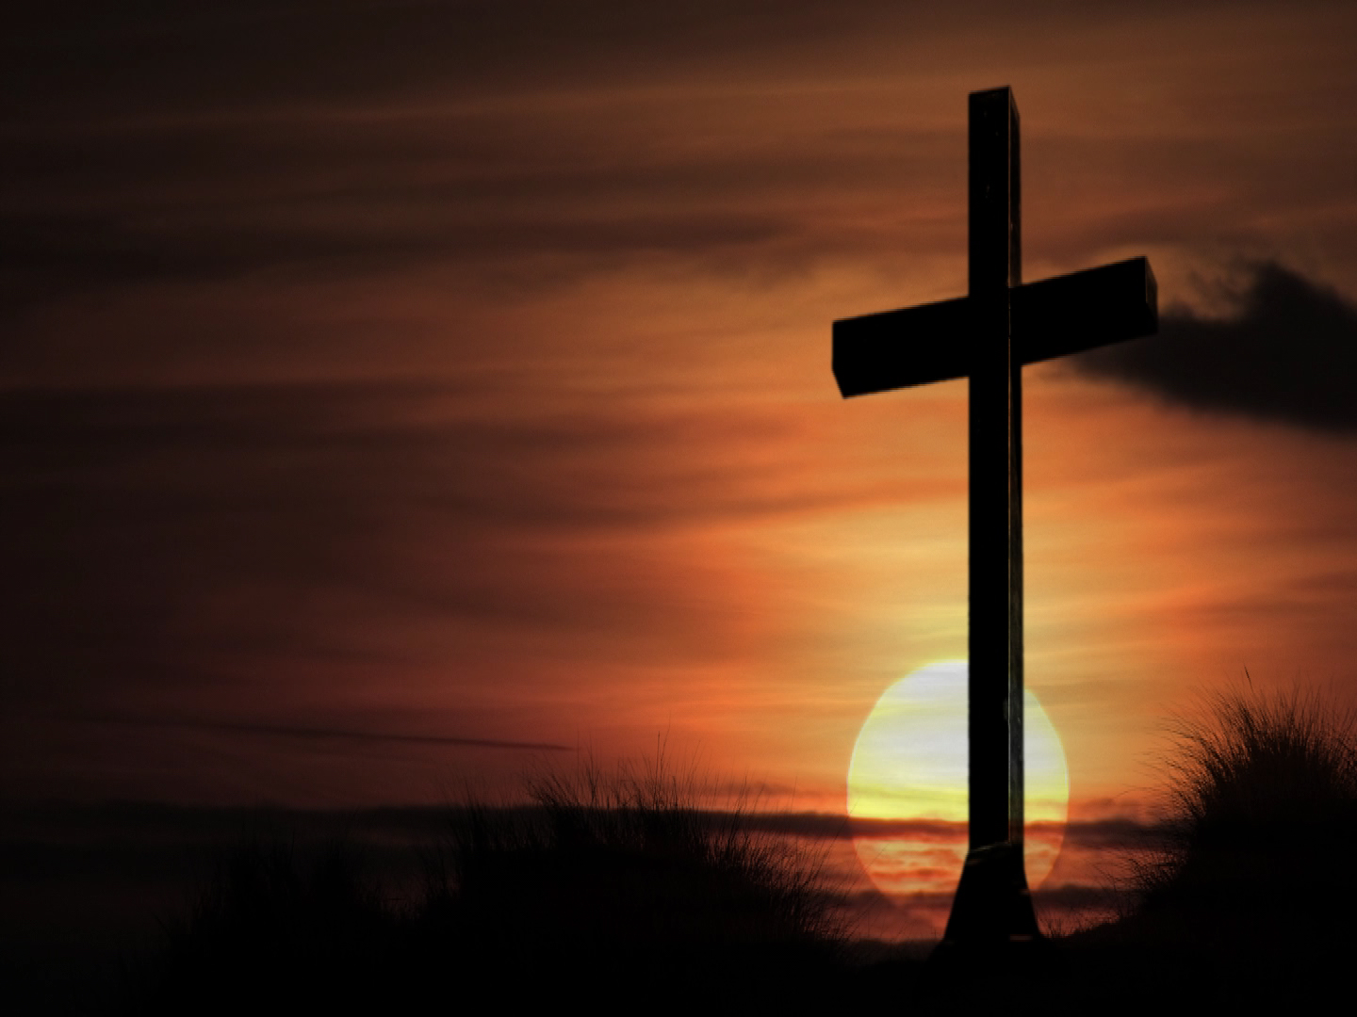
Lord’s Supper
Do this in remembrance of Me

Slide 28
Lord’s Supper
Matt. 26:47-50
…Judas, one of the twelve, with a great multitude with swords and clubs, came from the chief priests and elders of the people. 48 Now His betrayer had given them a sign, saying, "Whomever I kiss, He is the One; seize Him." 49 Immediately he went up to Jesus and said, "Greetings, Rabbi!" and kissed Him. 50 But Jesus said to him, "Friend, why have you come?“ Then they came and laid hands on Jesus and took Him.

Slide 29
Lord’s Supper
Matt. 27:27-30
…the soldiers of the governor took Jesus into the Praetorium and gathered the whole garrison around Him. 28 And they stripped Him and put a scarlet robe on Him. 29 When they had twisted a crown of thorns, they put it on His head, and a reed in His right hand. And they bowed the knee before Him and mocked Him, saying, "Hail, King of the Jews!" 30 Then they spat on Him, and took the reed and struck Him on the head.

Slide 30
Lord’s Supper
Matt. 27:31, 35-36
31 And when they had mocked Him, they took the robe off Him, put His own clothes on Him, and led Him away to be crucified.
35 Then they crucified Him, and divided His garments, casting lots that it might be fulfilled which was spoken by the prophet: "They divided My garments among them, And for My clothing they cast lots." 36 Sitting down, they kept watch over Him there.

Slide 31
Lord’s Supper
Matt. 27:39-40
And those who passed by blasphemed Him, wagging their heads 40 and saying, "You who destroy the temple and build it in three days, save Yourself! If You are the Son of God, come down from the cross.“

Slide 32
Lord’s Supper
Matt. 27:41-43
Likewise the chief priests also, mocking with the scribes and elders, said, 42 "He saved others; Himself He cannot save. If He is the King of Israel, let Him now come down from the cross, and we will believe Him. 43 He trusted in God; let Him deliver Him now if He will have Him; for He said, 'I am the Son of God.'"

Slide 33
Lord’s Supper
Matt. 27:44-46
Even the robbers who were crucified with Him reviled Him with the same thing. 45 Now from the sixth hour until the ninth hour there was darkness over all the land. 46 And about the ninth hour Jesus cried out with a loud voice, saying, "Eli, Eli, lama sabachthani?" that is, "My God, My God, why have You forsaken Me?"

Slide 34
Lord’s Supper
Matt. 27:50-51, 54
And Jesus cried out again with a loud voice, and yielded up His spirit. 51 Then, behold, the veil of the temple was torn in two from top to bottom; and the earth quaked, and the rocks were split…
54 So when the centurion and those with him, who were guarding Jesus, saw the earthquake and the things that had happened, they feared greatly, saying, "Truly this was the Son of God!"

Slide 35
Lord’s Supper
Matt. 28:1, 5-6
Now after the Sabbath, as the first day of the week began to dawn, Mary Magdalene and the other Mary came to the tomb…
5 the angel answered and said to the women, "Do not be afraid, for I know that you seek Jesus who was crucified. 6 He is not here; for He is risen, as He said. Come, see the place where the Lord lay.

Slide 36
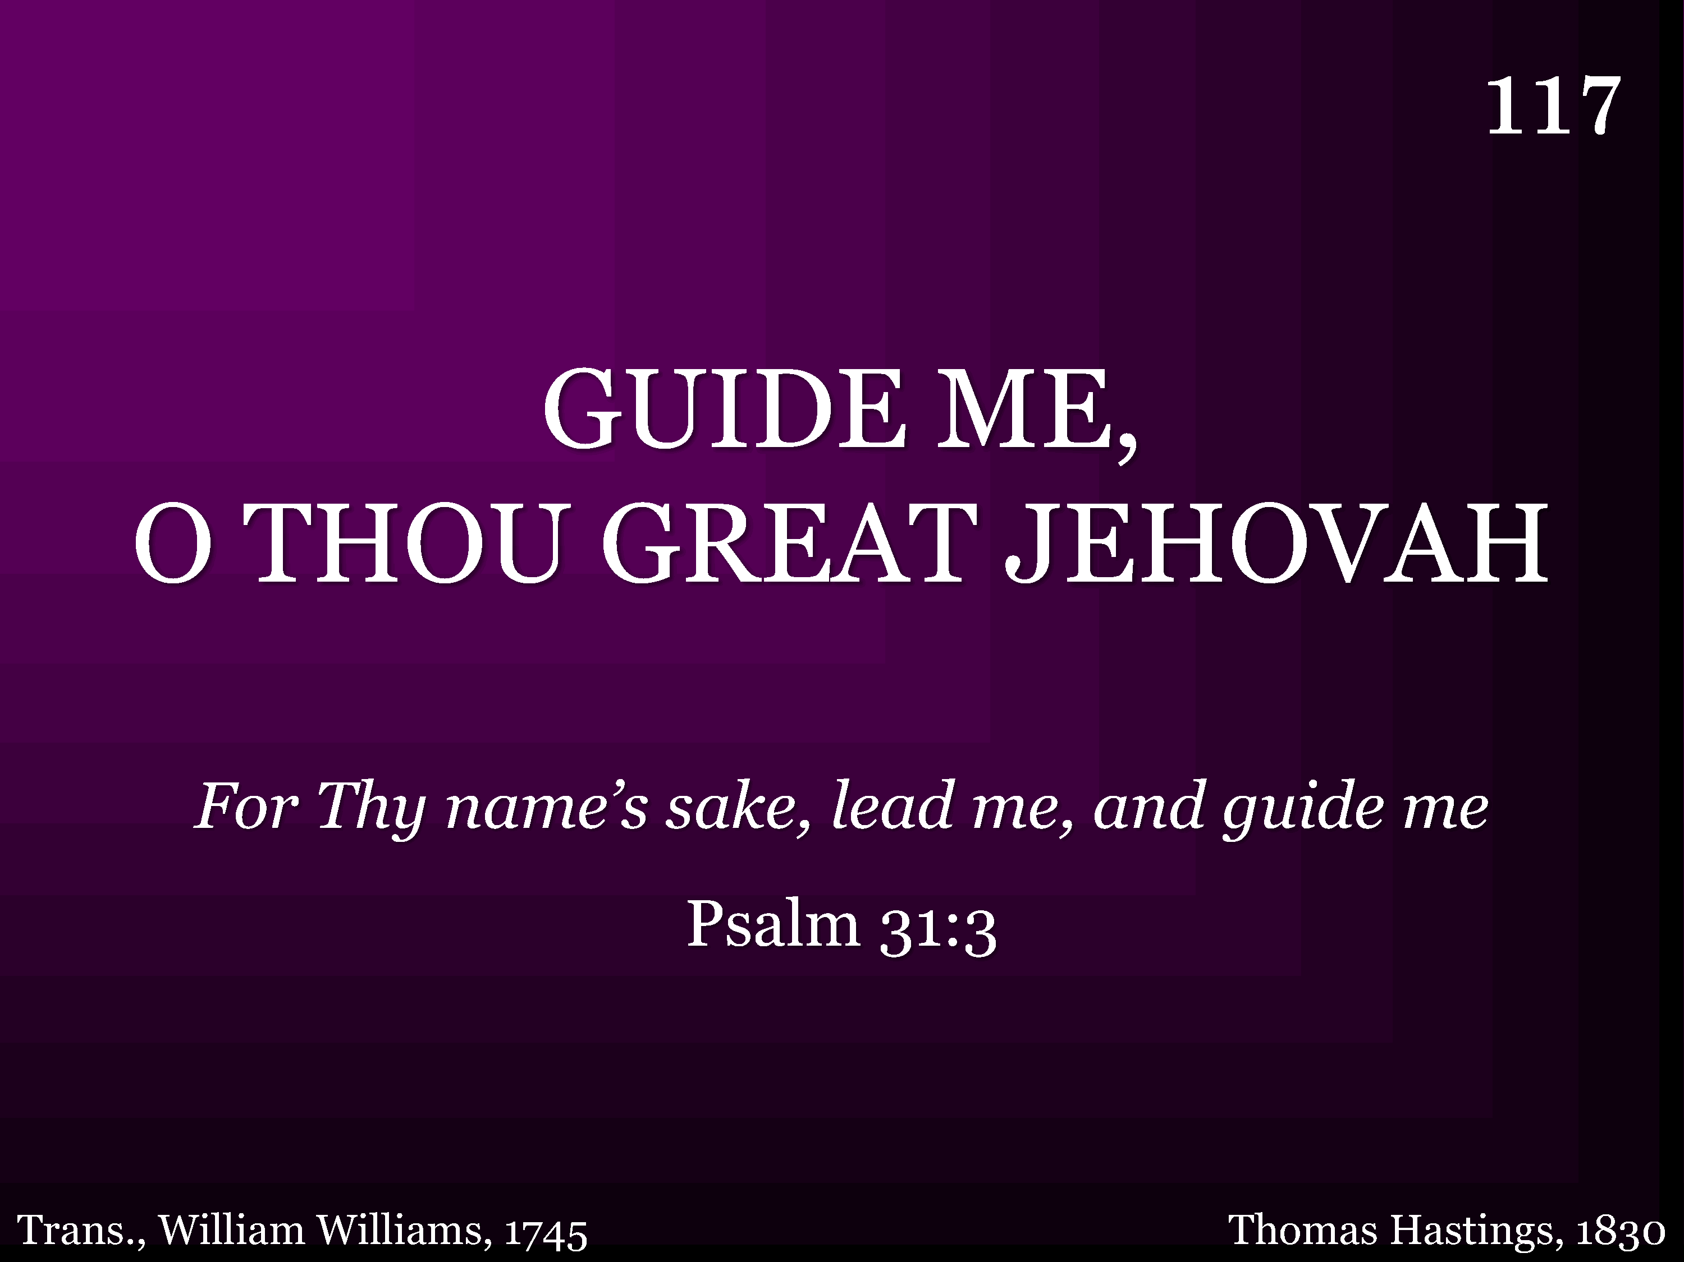
117 - Guide Me O Thou Great Jehovah - Title

Slide 37
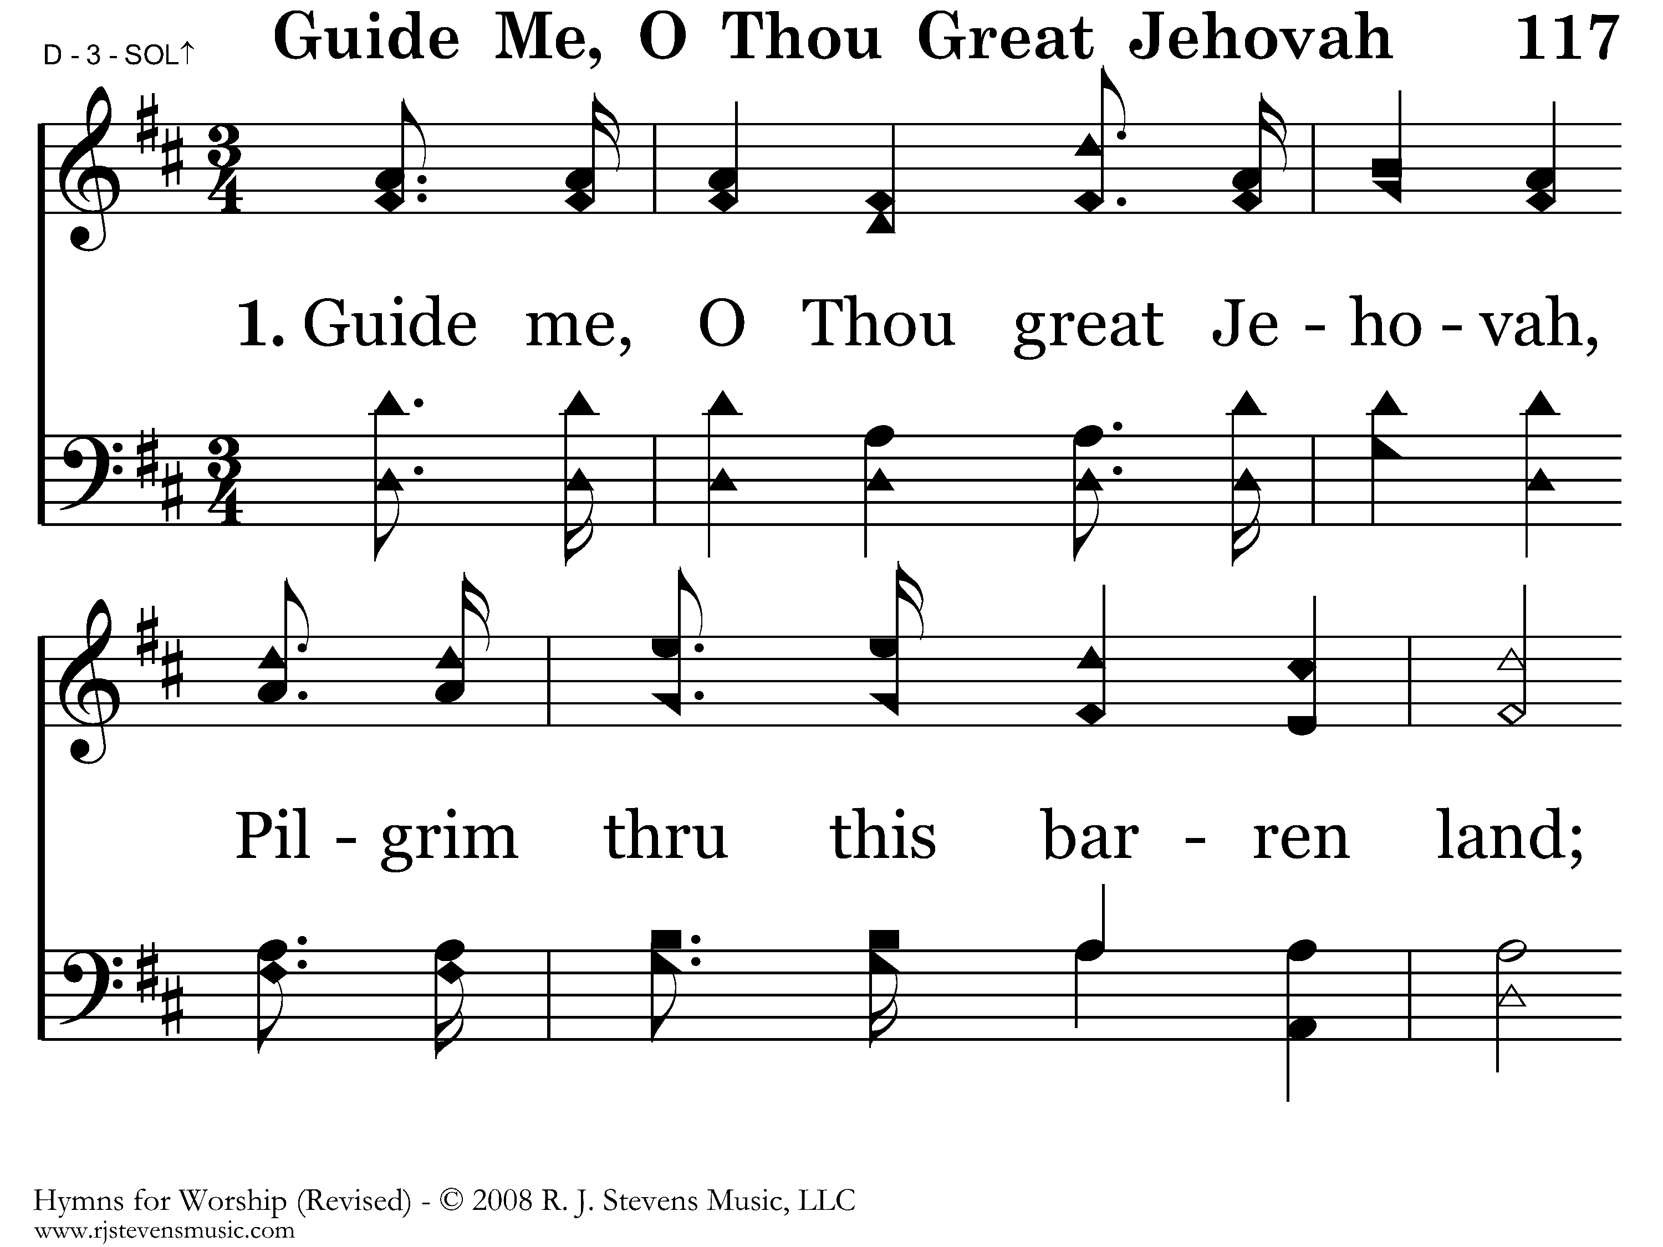
117 - Guide Me O Thou Great Jehovah - 1.1

Slide 38
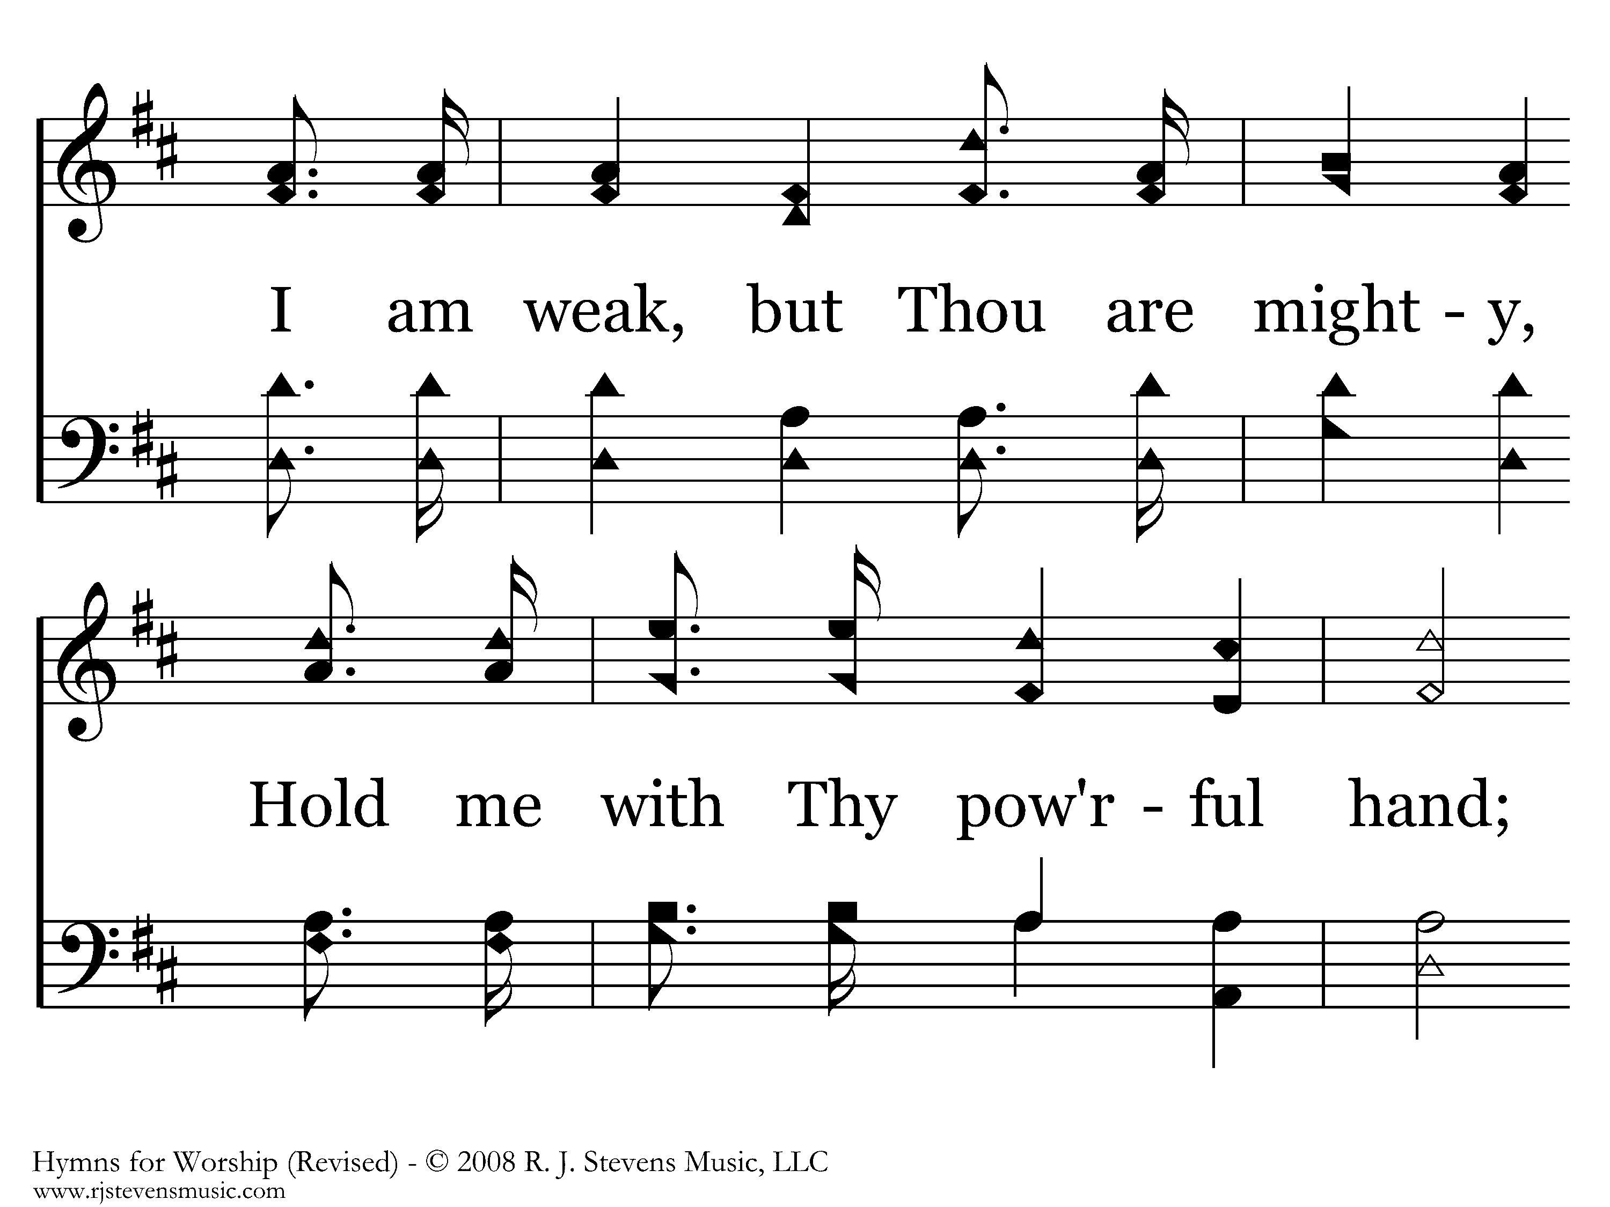
117 - Guide Me O Thou Great Jehovah - 1.2

Slide 39
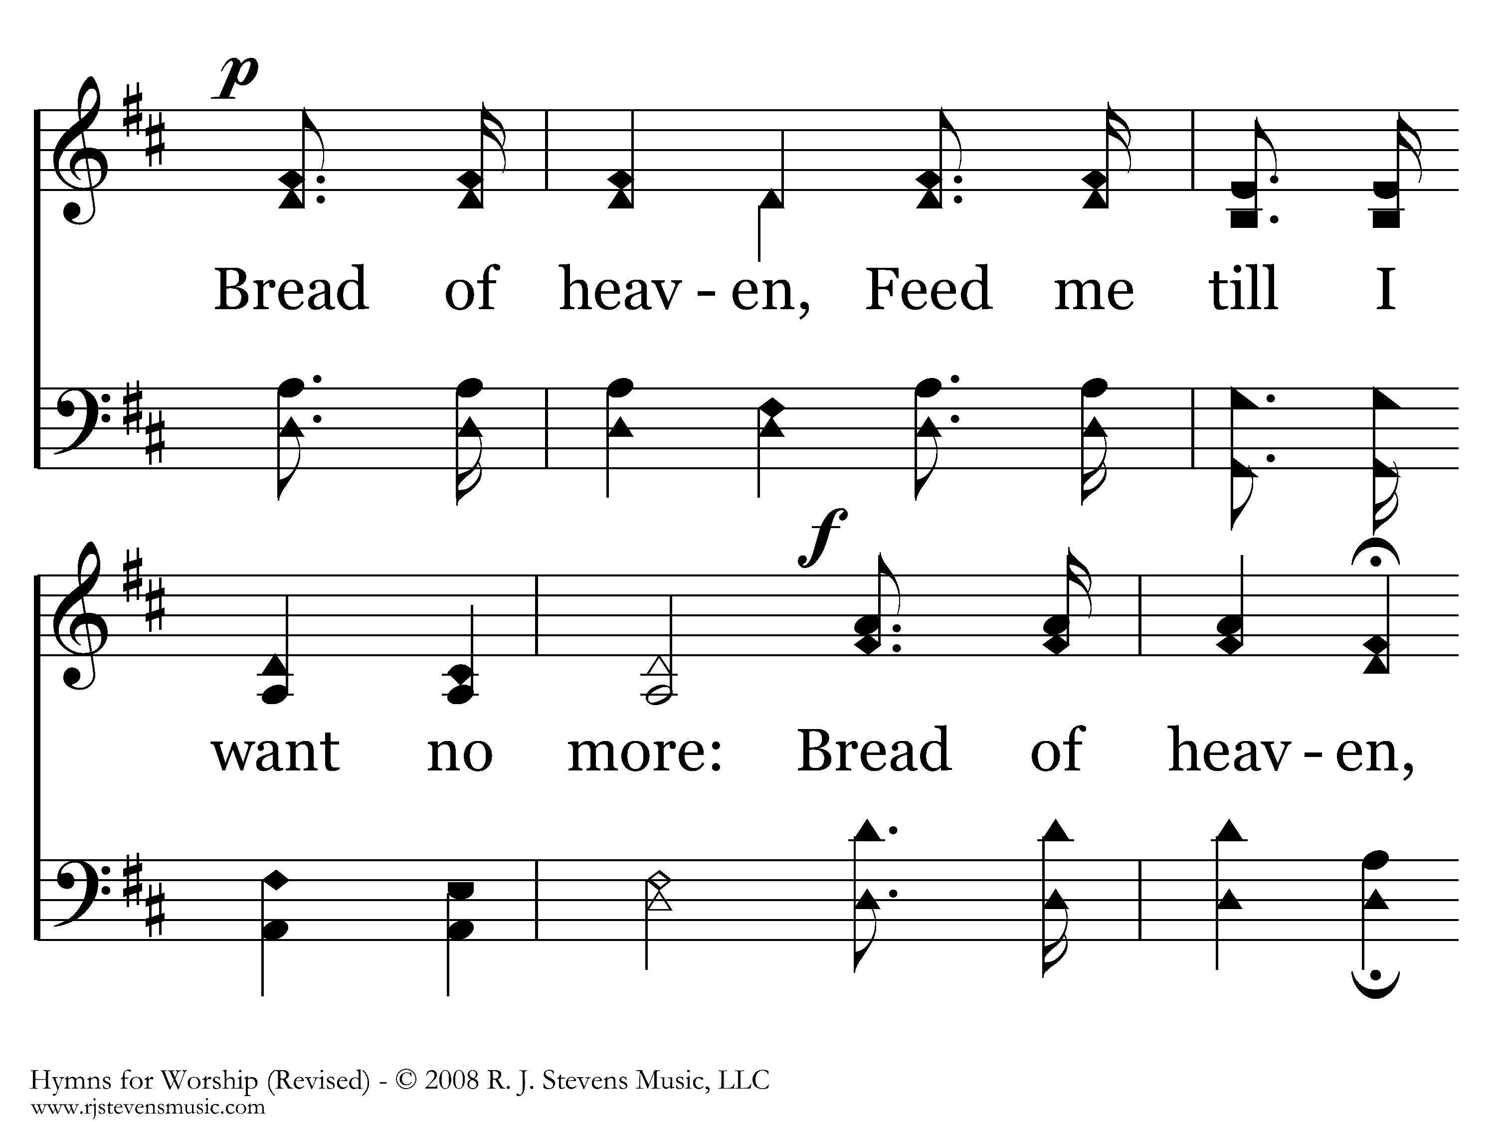
117 - Guide Me O Thou Great Jehovah - 1.3

Slide 40
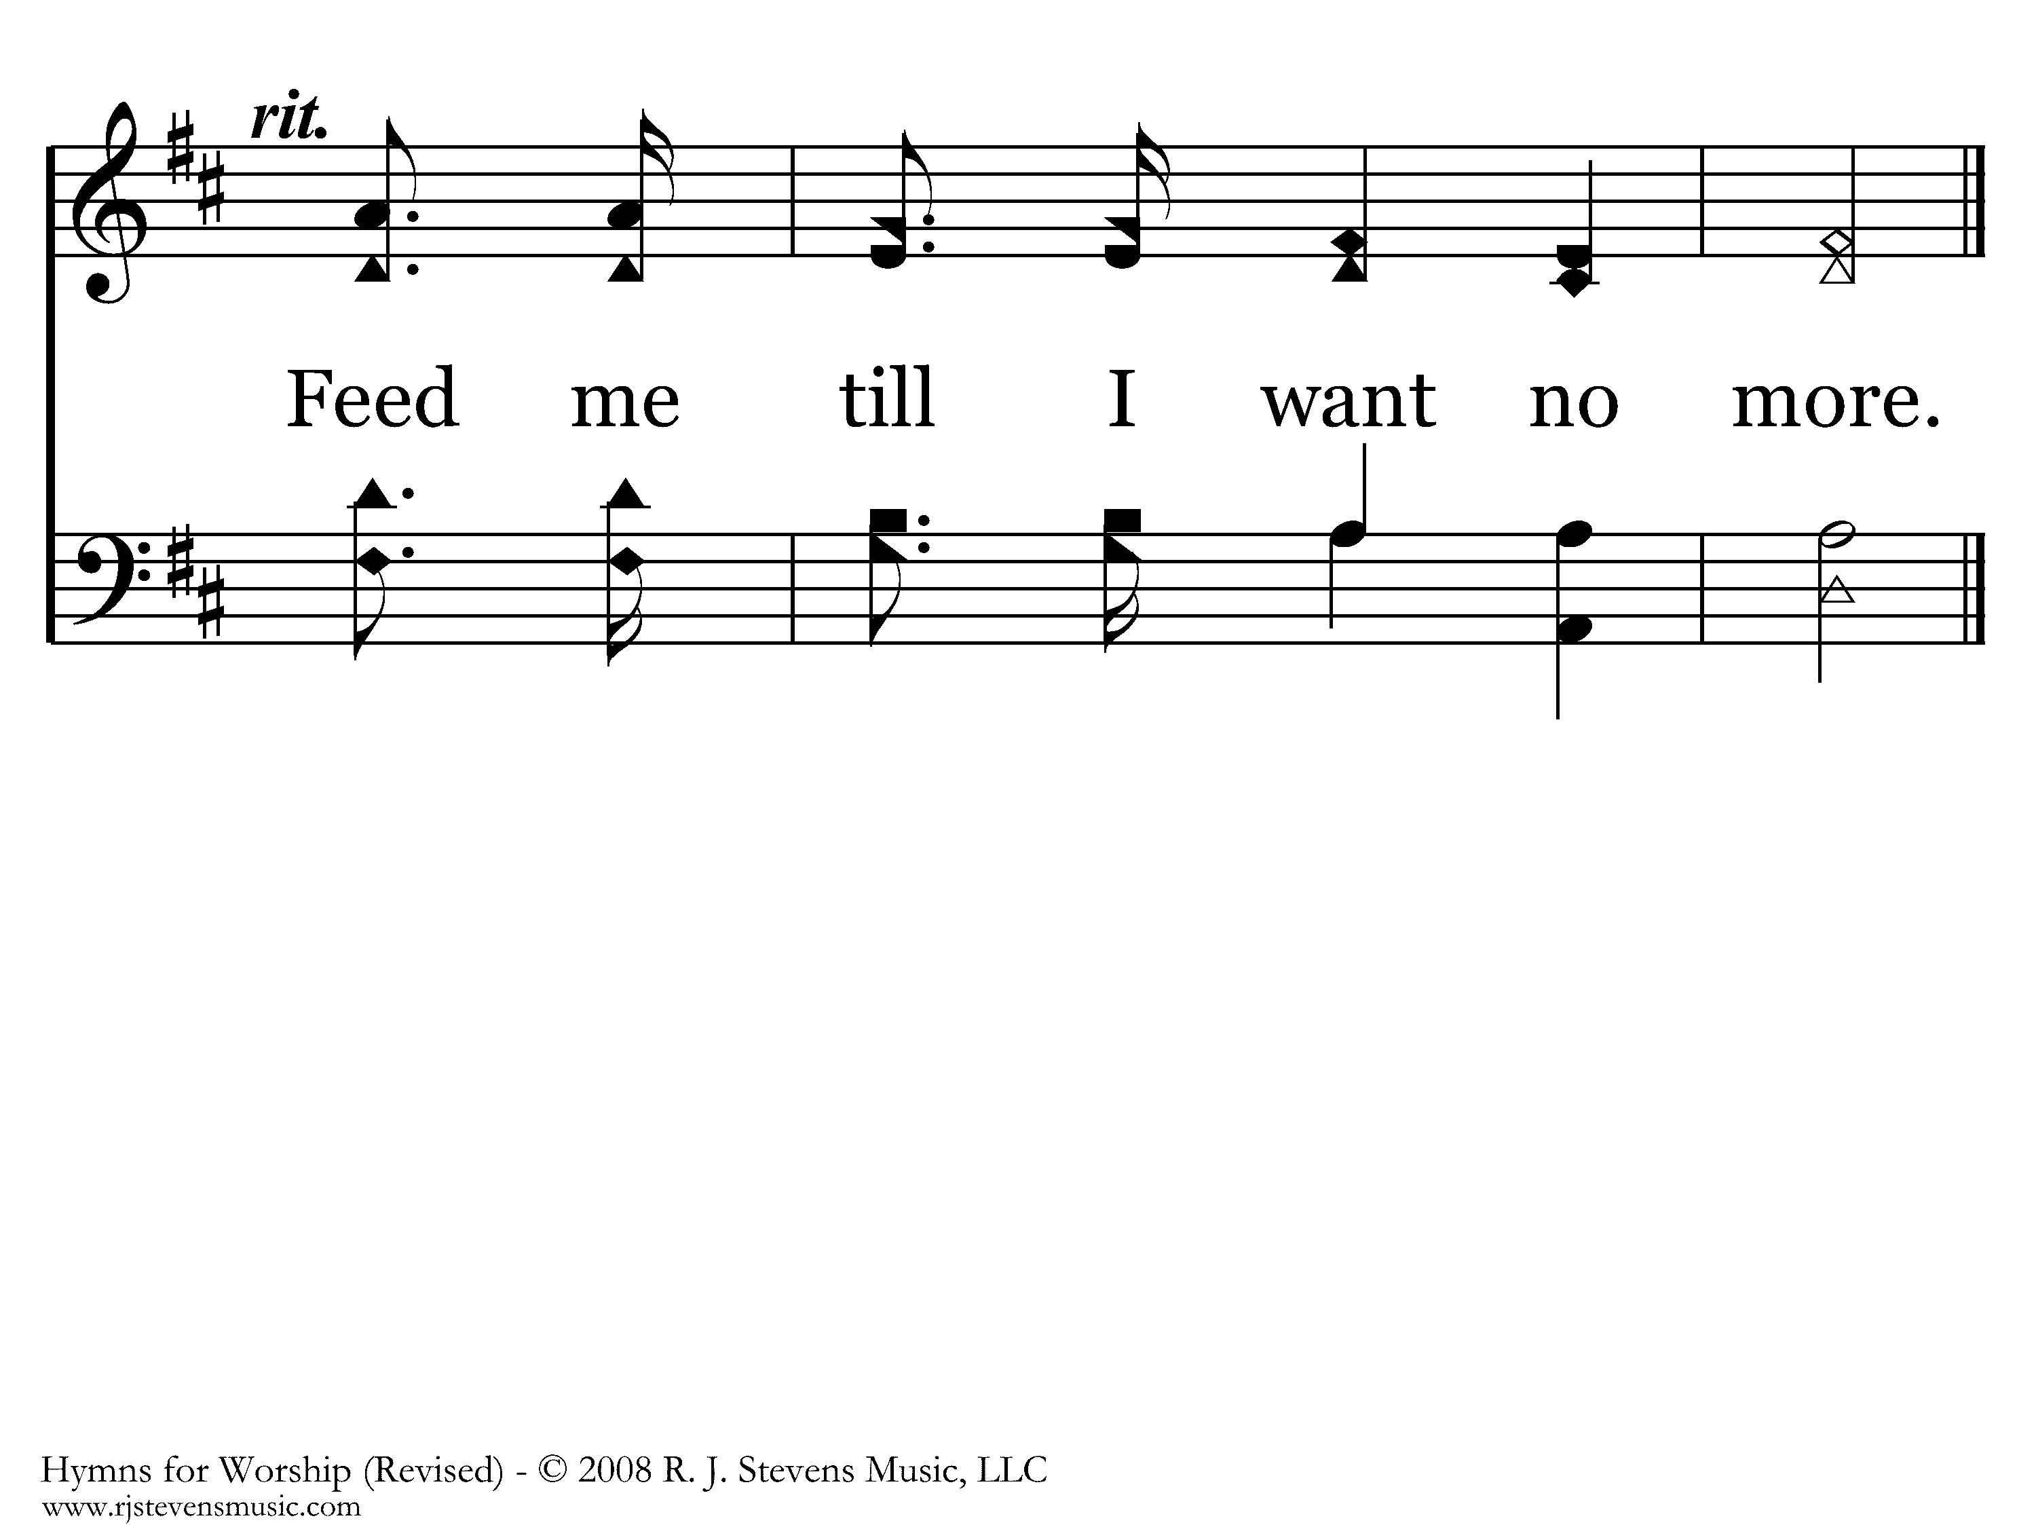
117 - Guide Me O Thou Great Jehovah - 1.4
End of Verse 1

Slide 41
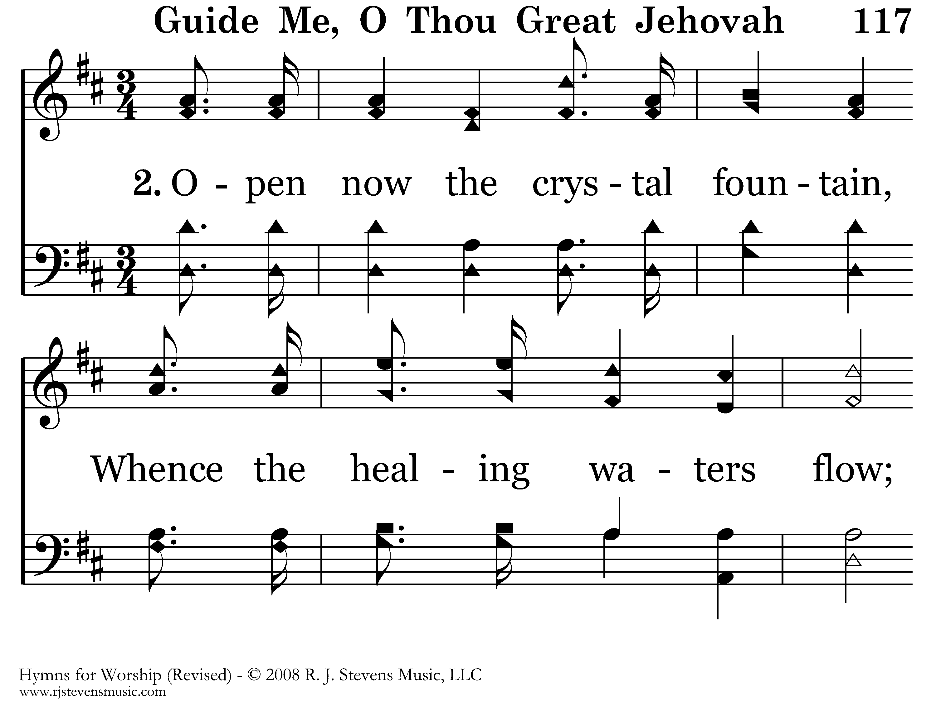
117 - Guide Me O Thou Great Jehovah - 2.1

Slide 42
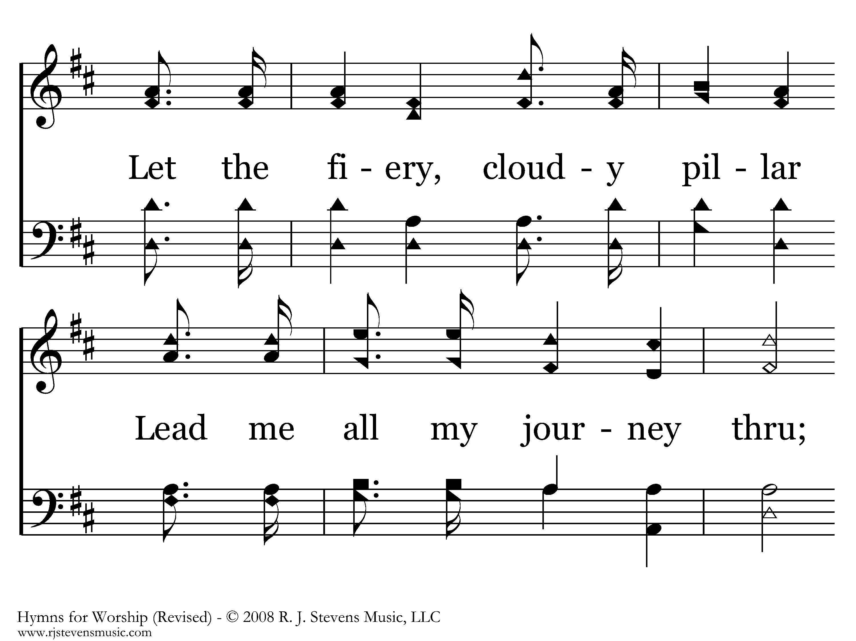
117 - Guide Me O Thou Great Jehovah - 2.2

Slide 43
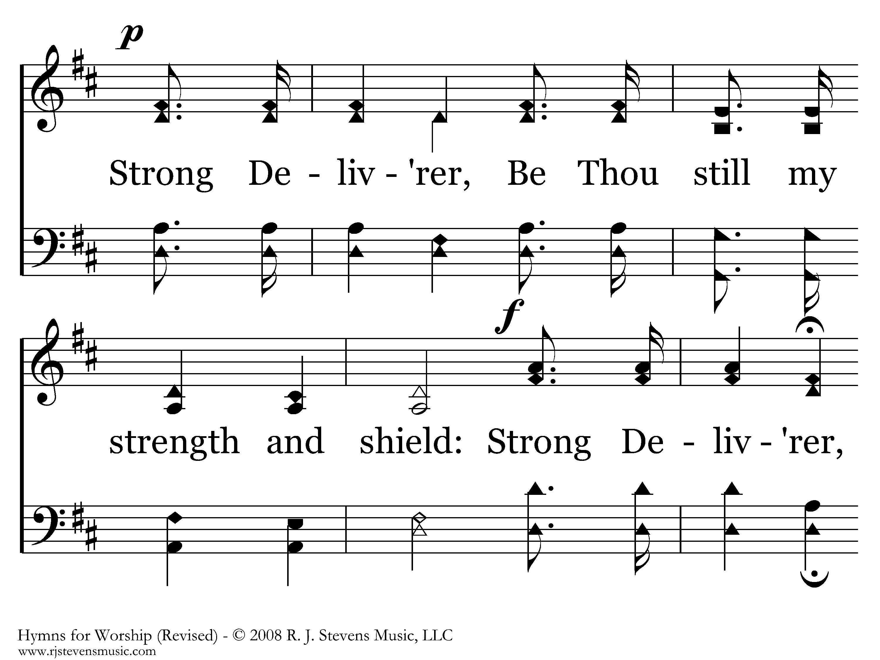
117 - Guide Me O Thou Great Jehovah - 2.3

Slide 44
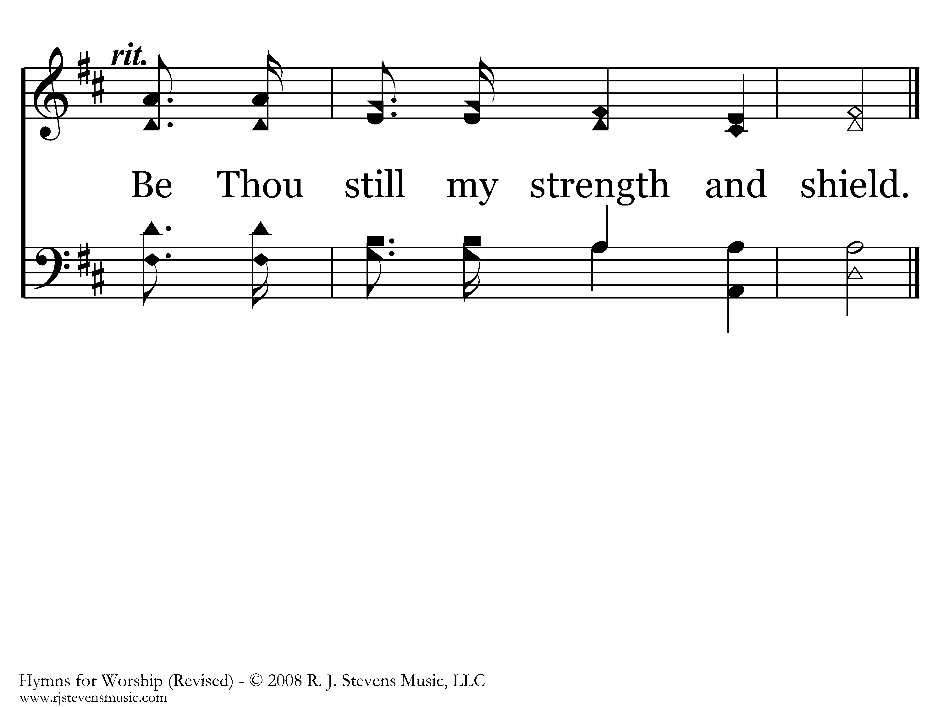
117 - Guide Me O Thou Great Jehovah - 2.4
End of Verse 2

Slide 45
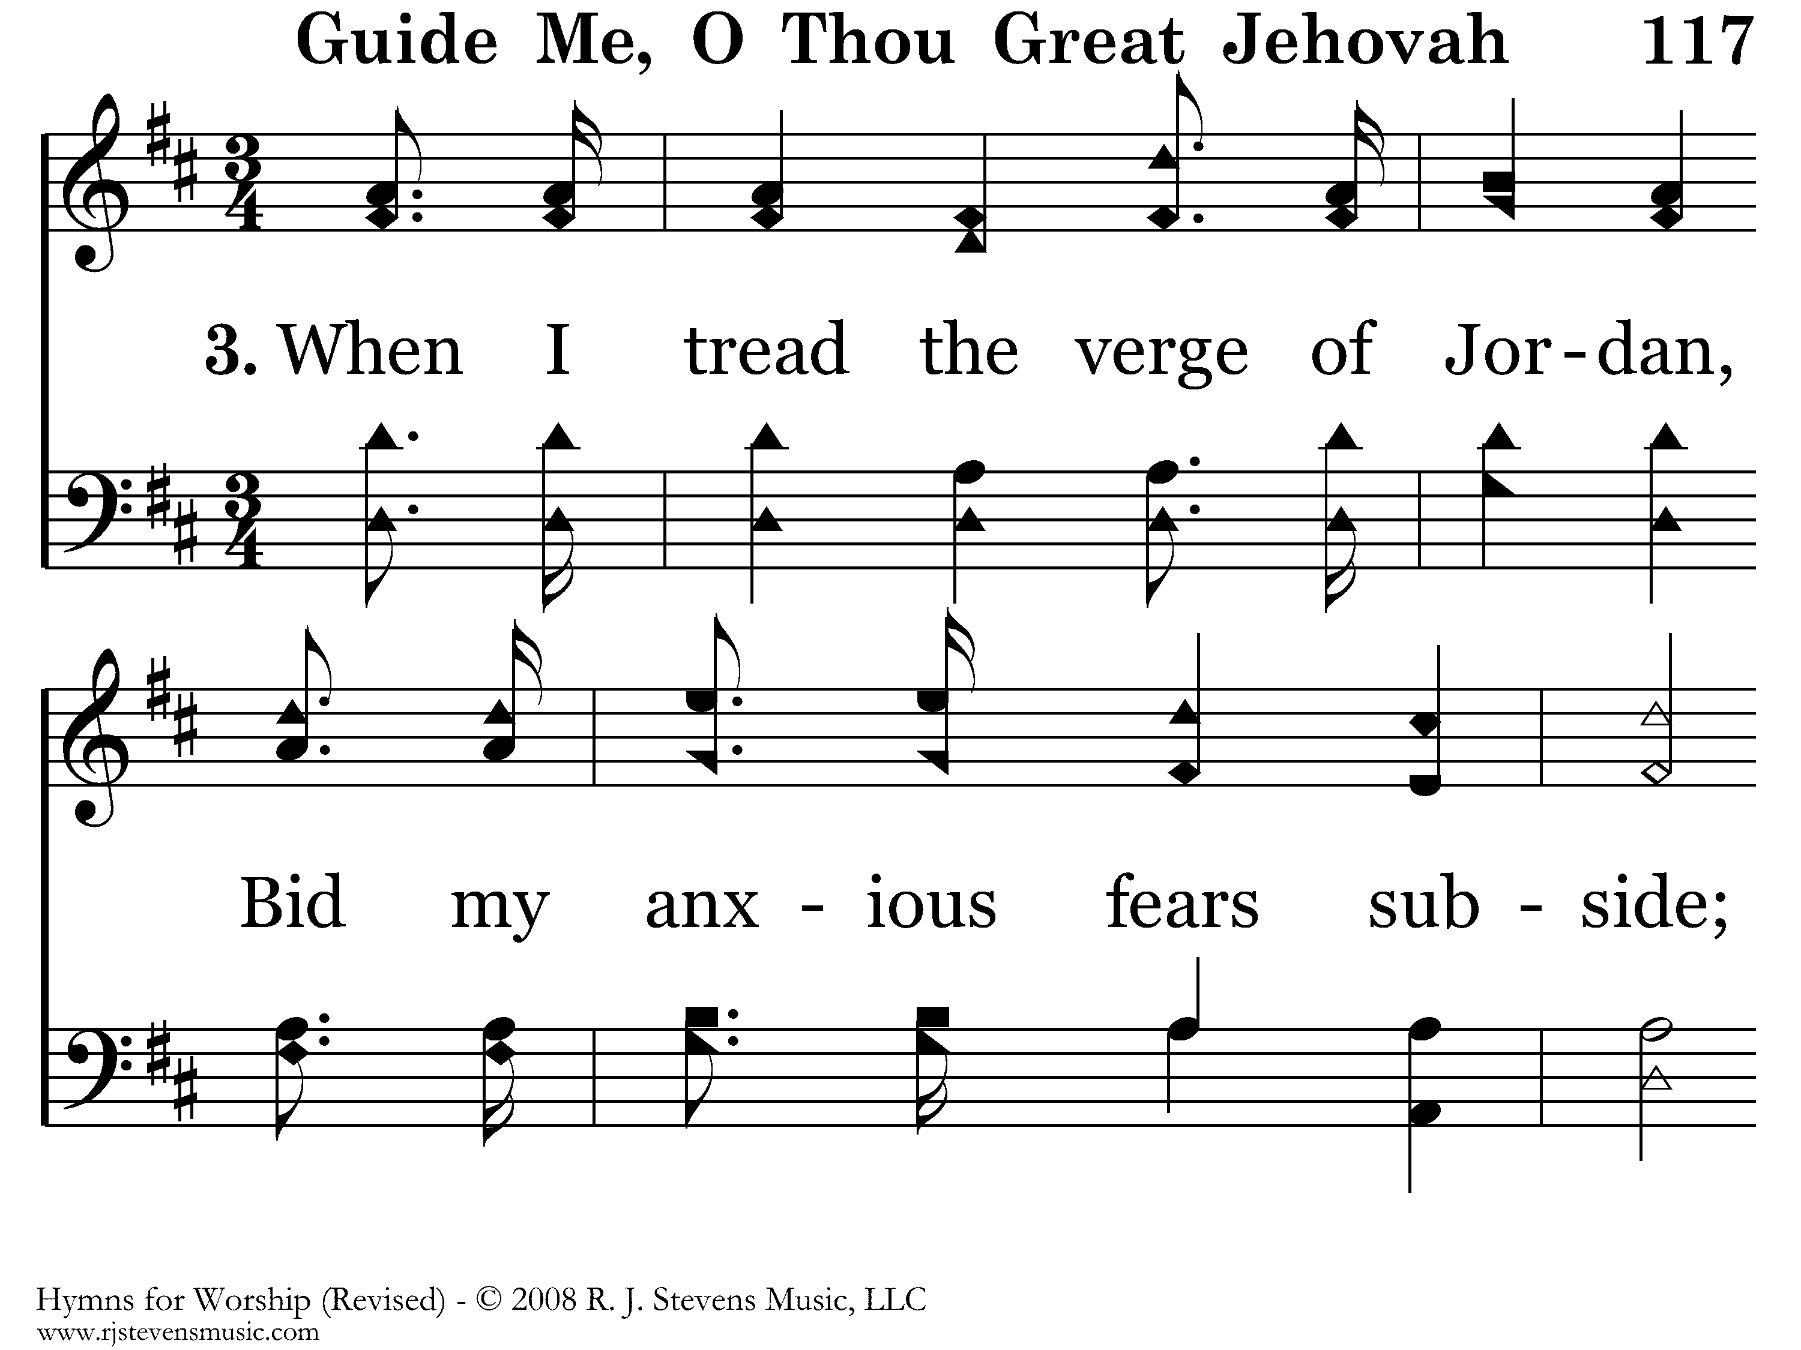
117 - Guide Me O Thou Great Jehovah - 3.1

Slide 46
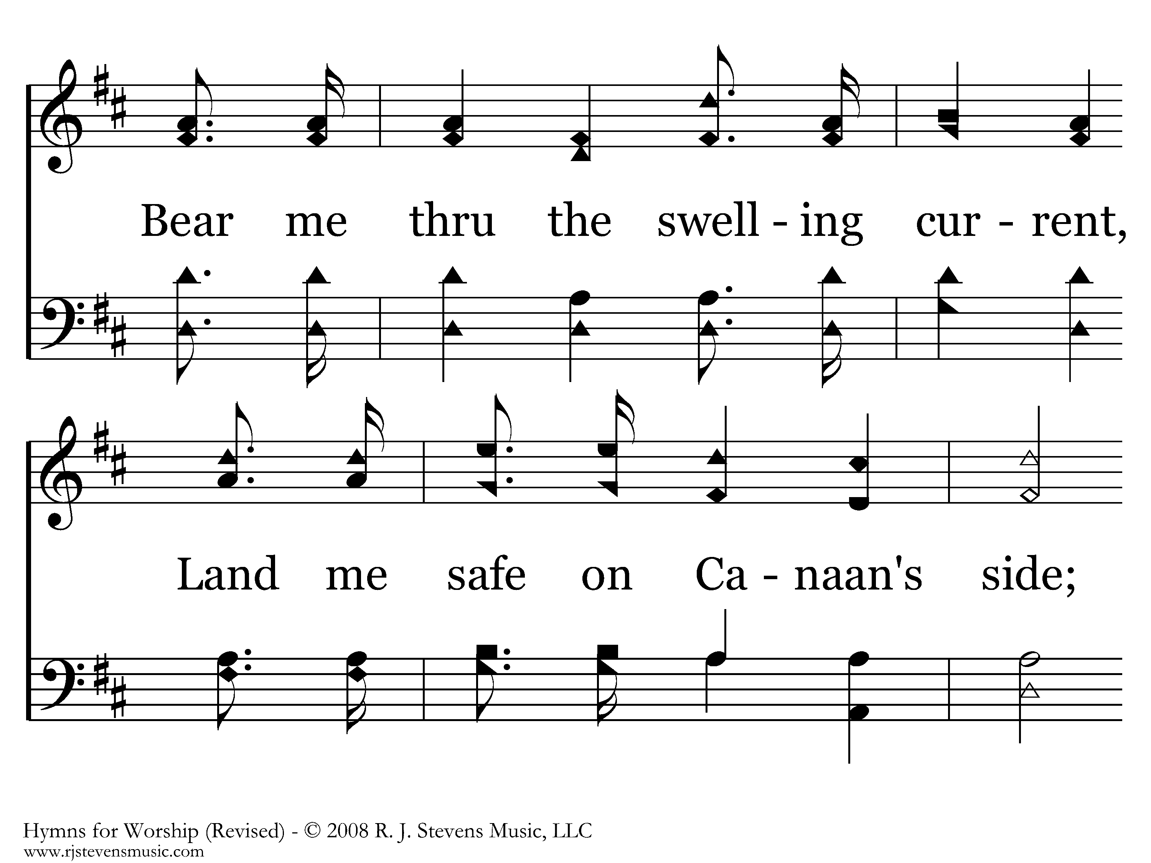
117 - Guide Me O Thou Great Jehovah - 3.2

Slide 47
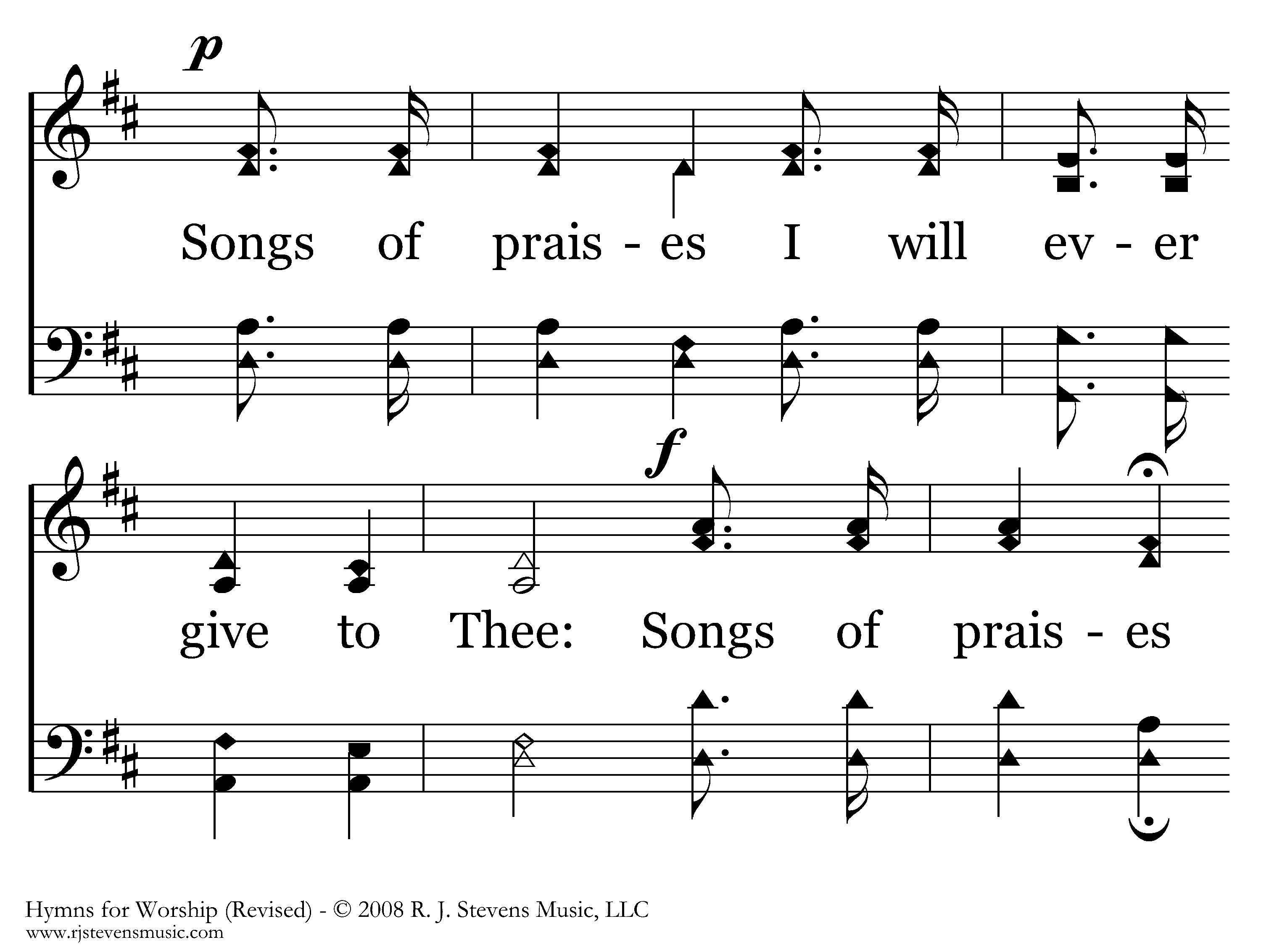
117 - Guide Me O Thou Great Jehovah - 3.3

Slide 48
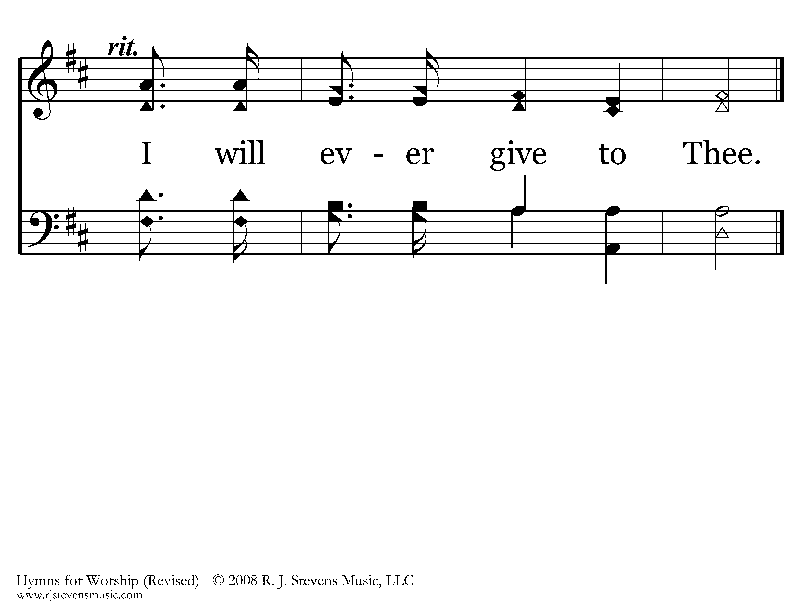
117 - Guide Me O Thou Great Jehovah - 3.4
End of Song

Slide 50
Proverbs 17:3
Testing the Heart

Slide 51
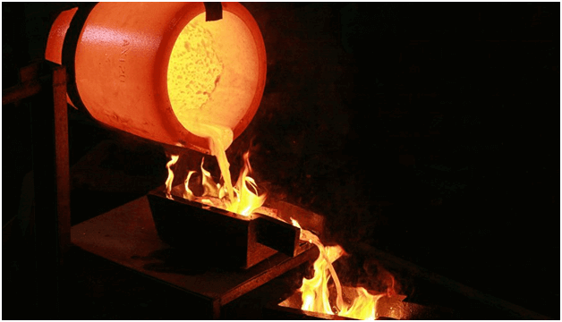
The refining pot is for silver and the furnace for gold,

Slide 52

but the Lord “tests” the hearts.

Slide 53
The Hebrew word translated as “test” in the OT is bachan.
It means to “examine, investigate, prove, scrutinize.”

Slide 54
The Greek word translated as “test” in the NT is dokimazo.
It means to “put to the test, prove, examine, and by implication, to approve.”

Slide 55
Why would God want to test the hearts of those who were created in His own image?

Slide 56
Genesis 1:26
… God said, “Let Us make man in Our image, according to Our likeness;

Slide 57
So why does God test us?

Slide 58
1. He tests us to build our faith in Him.

Slide 59
1. He tests us to build our faith in Him.
2. He tests us to prove our love for Him.

Slide 60
1. He tests us to build our faith in Him.
2. He tests us to prove our love for Him.
3. He tests us to increase our spiritual endurance to inherit our heavenly reward.

Slide 61
Deuteronomy 8:1-3
¹ “Every commandment which I command you today you must be careful to observe, that you may live and multiply, and go in and possess the land of which the Lord swore to your fathers.

Slide 62
Deuteronomy 8:1-3
² And you shall remember that the Lord your God led you all the way these forty years in the wilderness, to humble you and test you, to know what was in your heart, whether you would keep His commandments or not.

Slide 63
Deuteronomy 8:1-3
³ So He humbled you, allowed you to hunger, and fed you with manna which you did not know nor did your fathers know, that He might make you know that man shall not live by bread alone; but man lives by every word that proceeds from the mouth of the Lord.

Slide 64
NO ONE LIKES TO BE TESTED.

Slide 65
GOD’S TESTS COME AT UNEXPECTED MOMENTS IN OUR LIVES.

Slide 66
Noah – Genesis 6:1(b), 13-14(a)
^{1(b)} … Noah was a just man, perfect in his generations. Noah walked with God. ¹³ And God said to Noah, “The end of all flesh has come before Me, for the earth is filled with violence through them; and behold, I will destroy them with the earth. ^{14(a)} Make yourself an ark of gopherwood; …

Slide 67

Sometimes faith will make you look foolish;

Slide 68
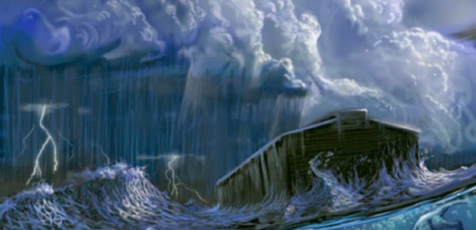
until it starts to rain.
- Noah

Slide 69
GOD’S TESTS WILL PROVIDE NEW CHALLENGES FOR US TO OVERCOME.

Slide 70
Abraham – Genesis 22:1-2
Now it came to pass after these things that God tested Abraham, and said to him, “Abraham!” And he said, “Here I am.” Then He said, “Take now your son, your only son Isaac, whom you love, and go to the land of Moriah, and offer him there as a burnt offering on one of the mountains of which I shall tell you.”

Slide 71
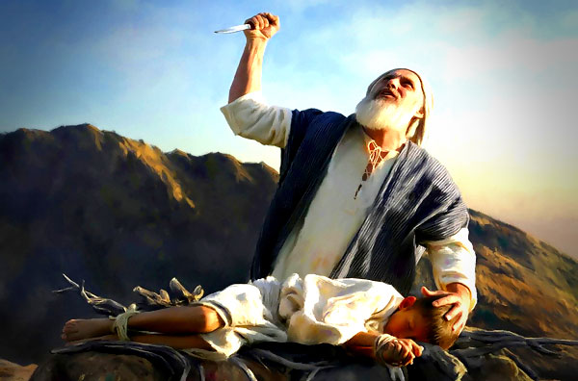

Slide 72
GOD’S TESTS WILL REVEAL WHAT WE VALUE MOST IN OUR LIVES.

Slide 73
Stephen – Acts 7:7:55-56, 59-60
⁵⁵ But he, being full of the Holy Spirit, gazed into heaven and saw the glory of God, and Jesus standing at the right hand of God, ⁵⁶ and said, “Look! I see the heavens open and Son of man standing at the right hand of God!” ⁵⁹ And they stoned Stephen as he was calling on God and saying, “Lord Jesus, receive my spirit.” ⁶⁰ Then he knelt

Slide 74
Stephen – Acts 7:55-56, 59-60 down and cried out with a loud voice, “Lord, do not charge them with this sin.” And when he had said this, he fell asleep.

Slide 75
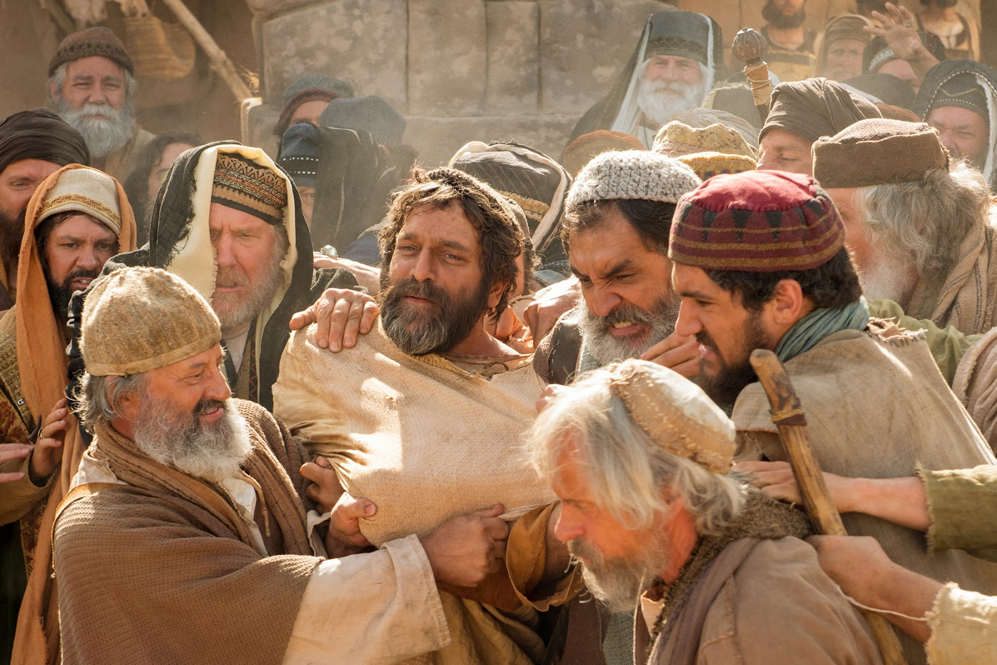

Slide 76
What about the tests
Job endured?

Slide 77
Job – Job 1:8 (The first time)
Then the Lord said to Satan, “Have you considered My servant Job, that there is none like him on the earth, a blameless and upright man, one who fears God and shuns evil?”

Slide 78
Job – Job 2:3 (The second time)
Then the Lord said to Satan, “Have you considered My servant Job, that there is none like him on the earth, a blameless and upright man, one who fears God and shuns evil? And still he holds fast to his integrity, although you incited Me against him, to destroy him without cause.”

Slide 79
Job – Job 2:9-10 (Job’s wife speaks)
Then his wife said to him, “Do you still hold fast to your integrity? Curse God and die!”
But he said to her, “You speak as one of the foolish women speaks. Shall we indeed accept good from God, and shall we not accept adversity?” In all this Job did not sin with his lips.

Slide 80
James 5:11
Indeed we count them blessed who endure. You have heard of the perseverance of Job and seen the end intended by the Lord— that the Lord is very compassionate and merciful.

Slide 81
Have you ever thought about …

Slide 82
Satan striking Job with boils and the impact that COVID has on us today?
Different, but similar in the way they both effect the flesh. And some are letting COVID effect their service and worship to God.

Slide 83
Hebrews 11:35(b)-38
… Others were tortured … trials of mockings and scourgings … of chains and imprisonment … stoned … sawn in two … tempted … slain with the sword … wandered about in sheepskins and goatskins … destitute … afflicted … tormented — ³⁸ of whom the world was not worthy. They wandered in deserts and mountains, in dens and caves.

Slide 84
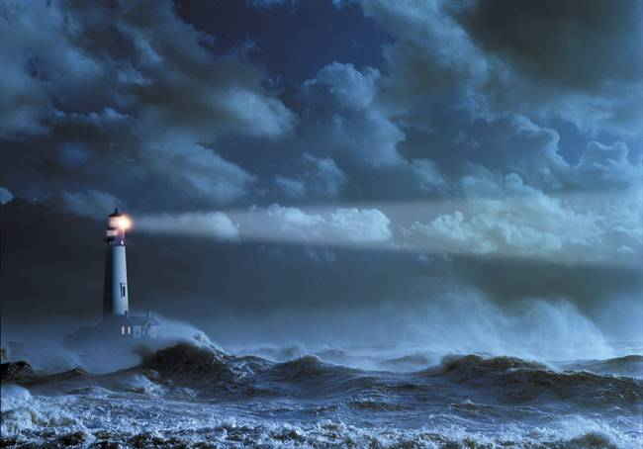
Do not pray for an easy life.
Pray for the strength to endure a difficult one.

Slide 85
Jeremiah 17:10
I, the Lord, search the heart, I test the mind, even to give every man according to his ways, according to the fruit of his doings.

Slide 86
Remember – Five, Two, One ?

Slide 87
Matthew 25:14-15
For the kingdom of heaven is like a man traveling to a far country, who called his own servants and delivered his goods to them. And to one he gave five talents, to another two, and to another one, to each according to his own ability; and immediately he went on a journey.

Slide 88
Matthew 25:24-25
Then he who had received the one talent came and said, “Lord, I knew you to be a hard man, reaping where you have not sown, and gathering where you have not scattered seed. And I was afraid and went and hid your talent in the ground. Look, there you have what is yours.

Slide 89
Matthew 25:26-28
But his lord answered and said to him, “You wicked and lazy servant, you knew that I reap where I have not sown and gather where I have not scattered seed. So, you ought to have deposited my money with the bankers, and at my coming I would have received back my own with interest.

Slide 90
Matthew 25:29-30
So, take the talent from him, and give it to him who has ten talents. For to everyone who has, more will be given, and he will have abundance; but from him who does not have, even what he has will be taken away. And cast the unprofitable servant into the outer darkness. There will be weeping and gnashing of teeth.”

Slide 91

Our stewardship of what God has blessed us with is our test of faith toward Him.

Slide 92
James 1:2-5
My brethren, count it all joy when you fall into various trials, knowing that the testing of your faith produces patience. ⁴ But let patience have its perfect work, that you may be perfect and complete, lacking nothing. If any of you lacks wisdom, let him ask of God, who gives to all liberally and without reproach, and it will be given to him.

Slide 93

Opportunity may knock only once, but temptation leans on the doorbell.

Slide 94

Galatians 6:9
And let us not grow weary while doing good, for in due season we shall reap if we do not lose heart.

Slide 95
“Growing old is not for the weak.”
There is no place in the body of Christ for the faithless; those who give up at every challenge or under every test they face in life. When we feel like giving up, remember the fearful servant that hid his master’s talent in the ground.

Slide 96

It’s not just a religion.
It’s a relationship.
It’s a way of life.

Slide 98
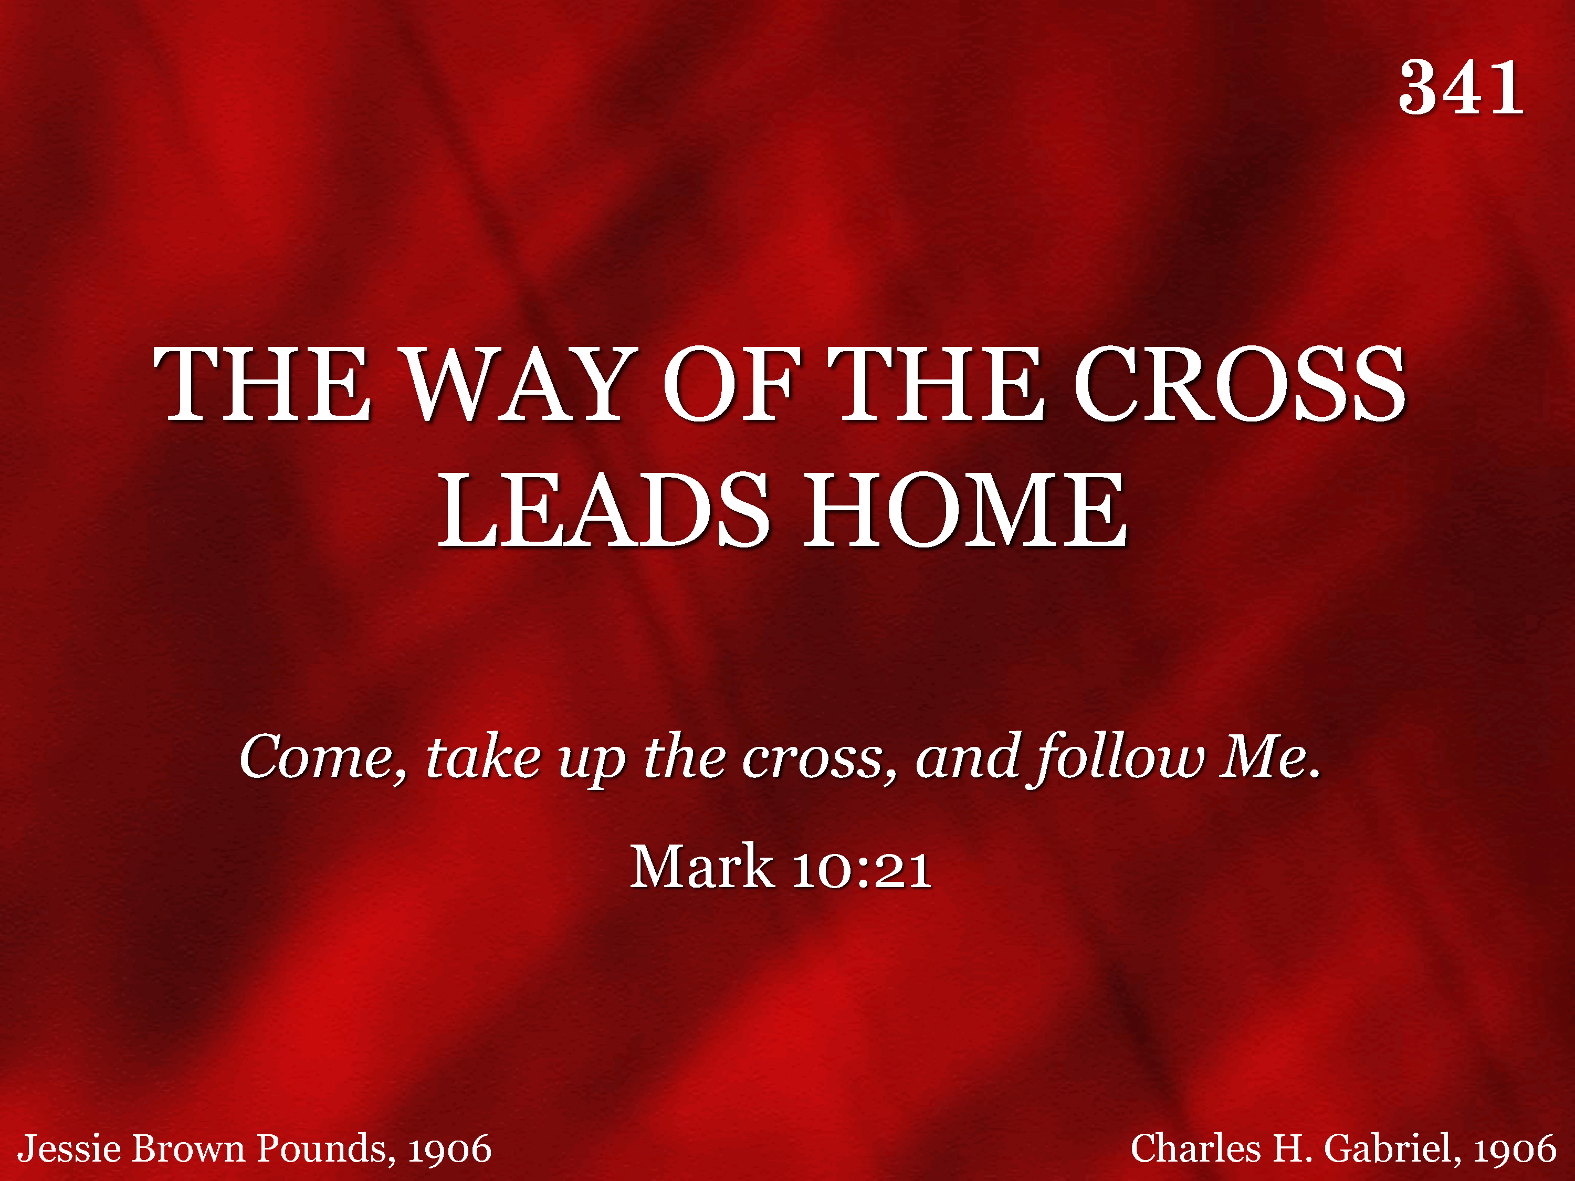
341 - The Way Of The Cross Leads Home - Title

Slide 99
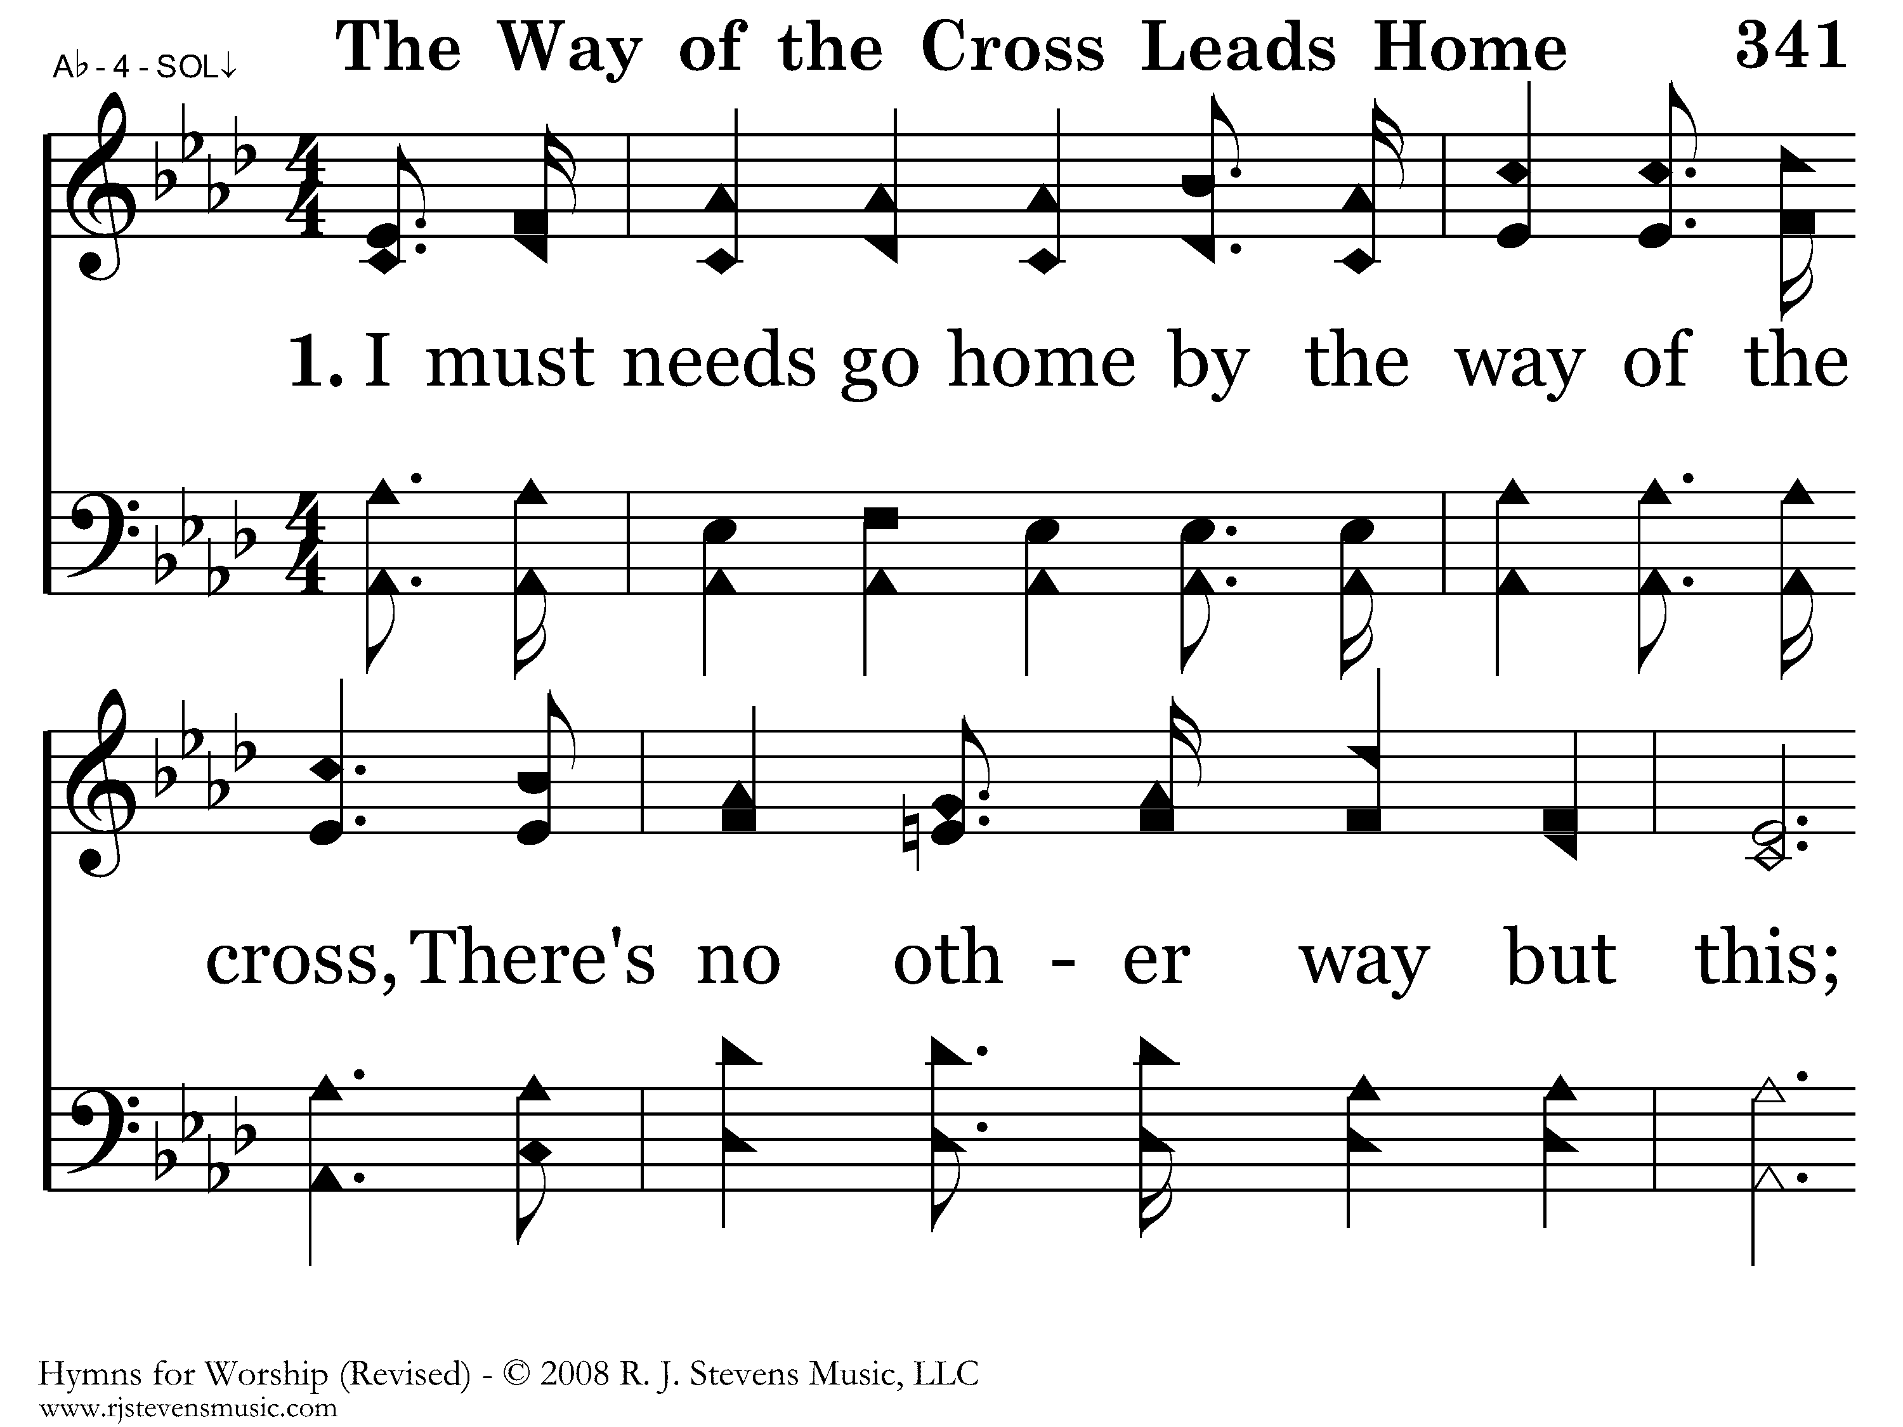
341 - The Way Of The Cross Leads Home - 1.1

Slide 100
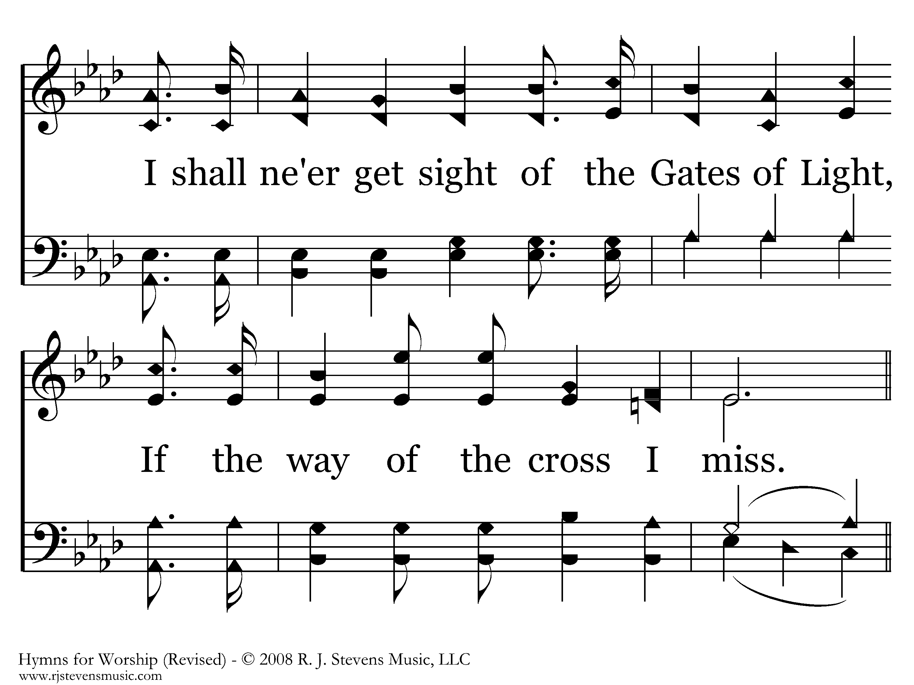
341 - The Way Of The Cross Leads Home - 1.2

Slide 101
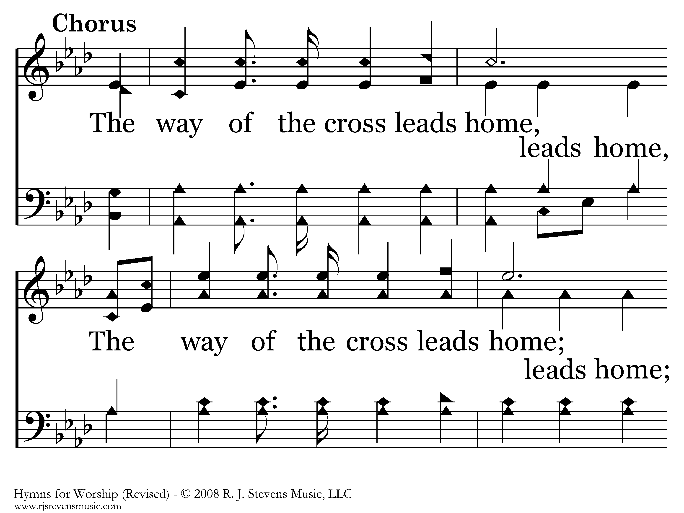
341 - The Way Of The Cross Leads Home - C.1

Slide 102
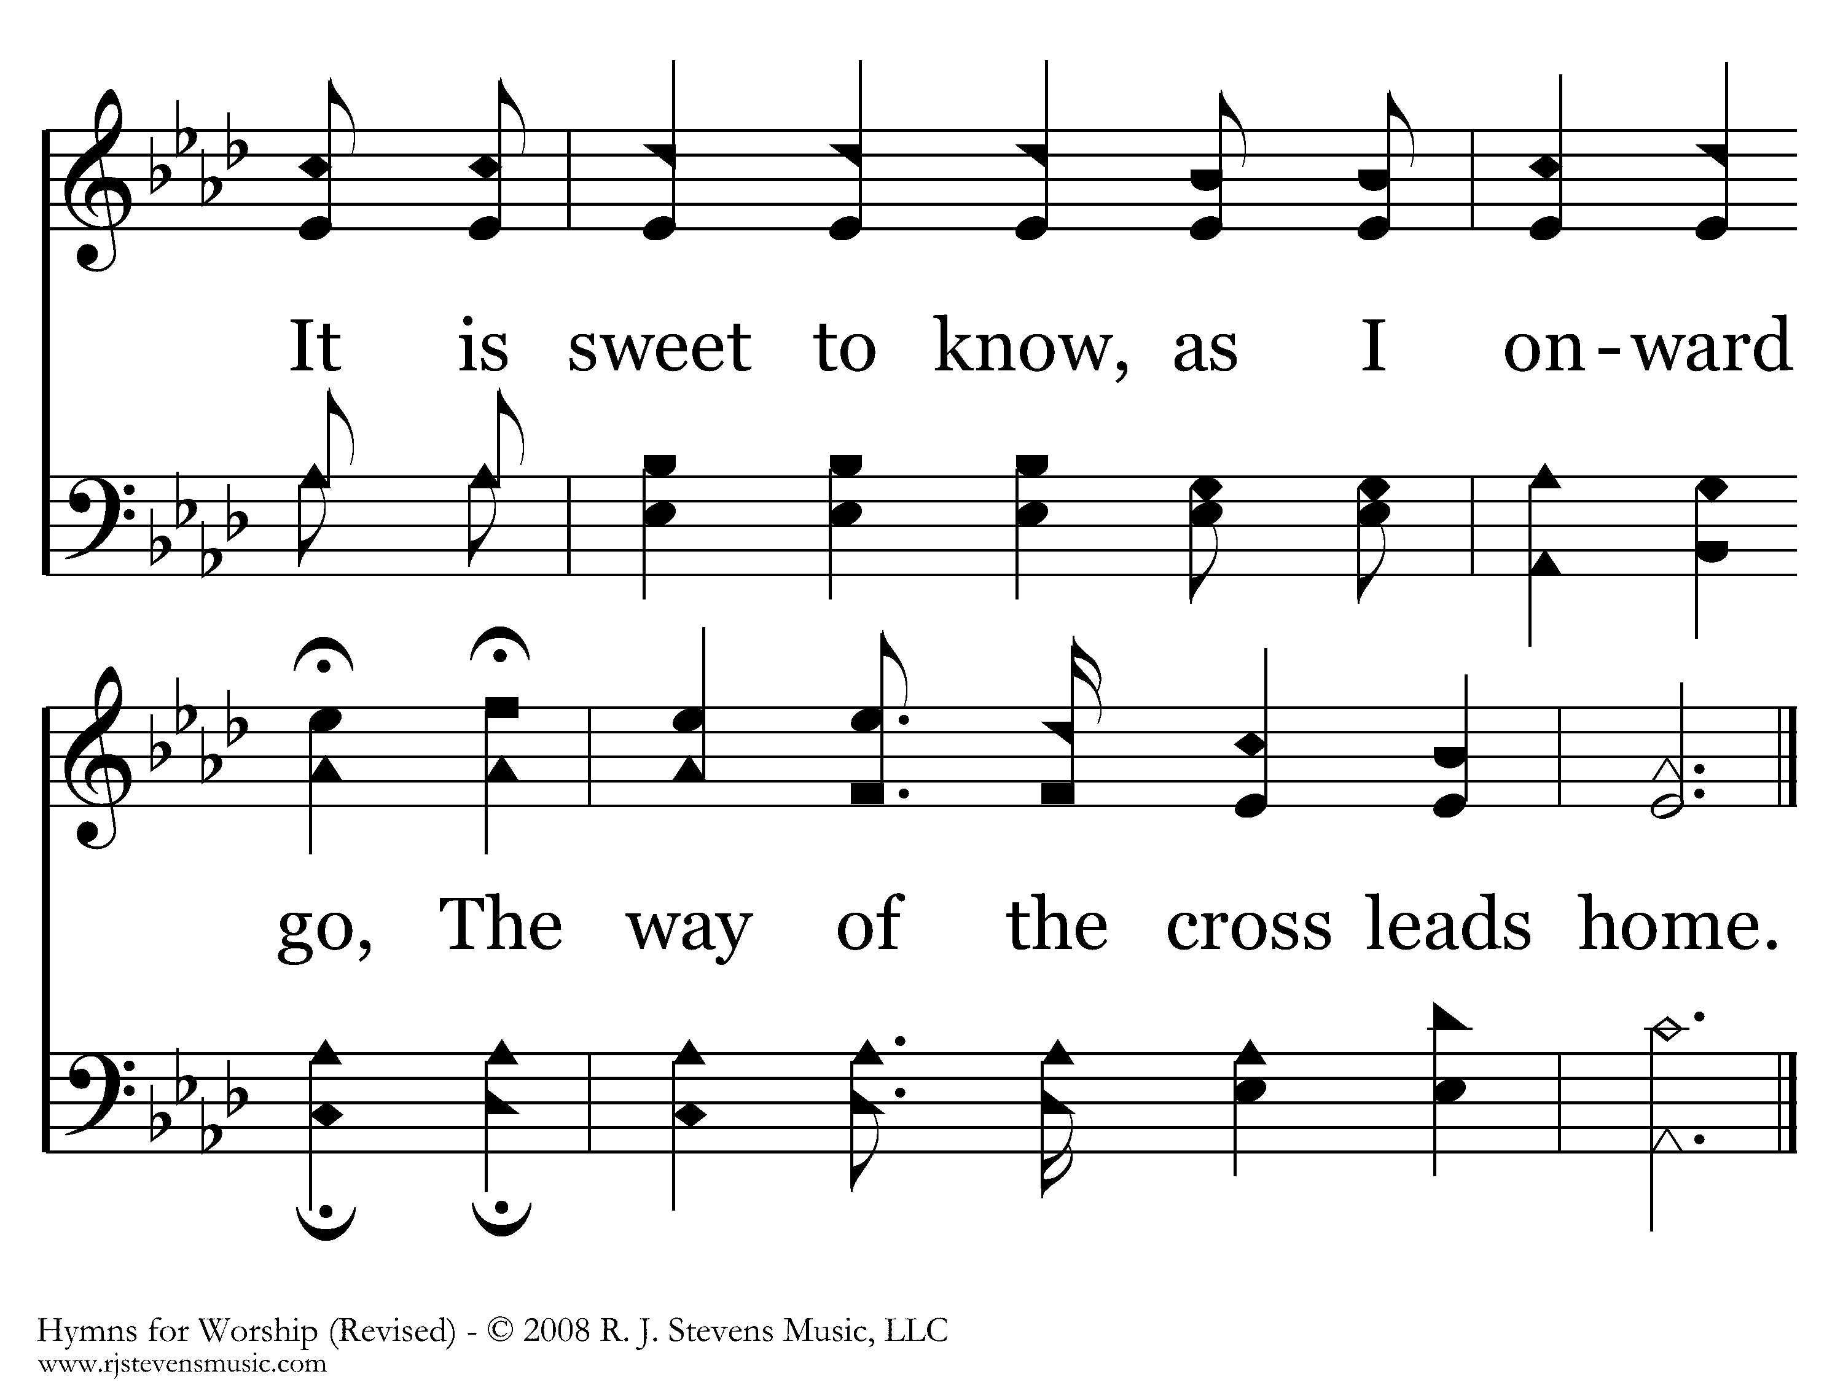
341 - The Way Of The Cross Leads Home - C.2
End of Verse 1

Slide 103
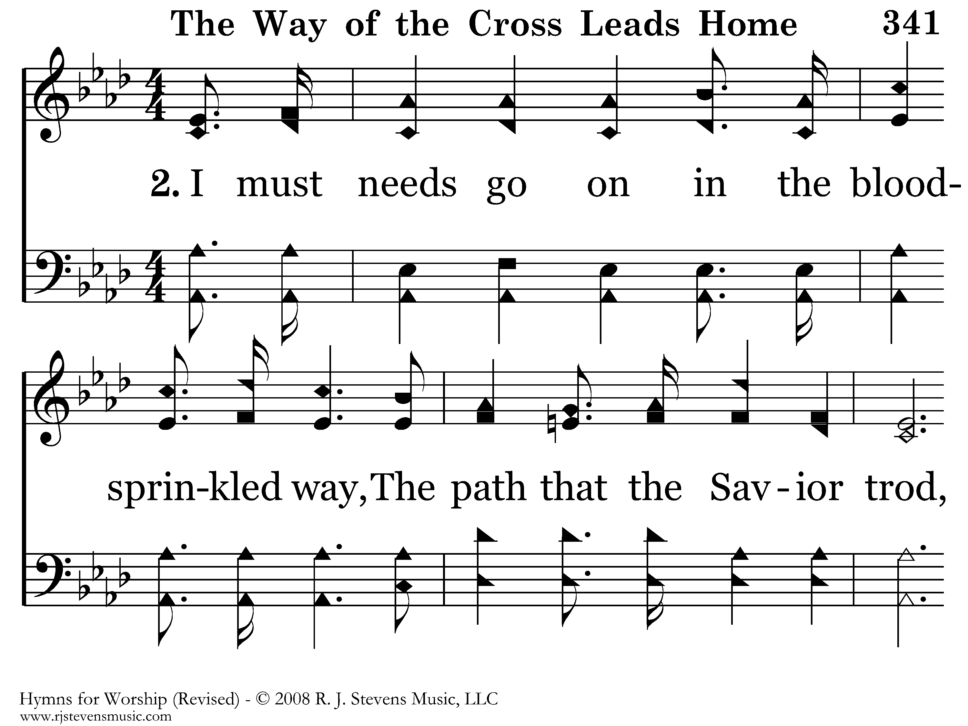
341 - The Way Of The Cross Leads Home - 2.1

Slide 104
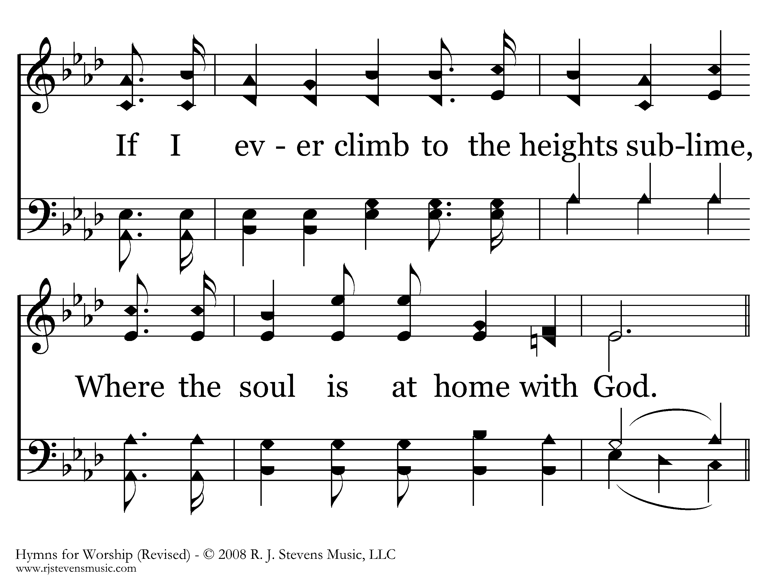
341 - The Way Of The Cross Leads Home - 2.2

Slide 105
341 - The Way Of The Cross Leads Home - C.1

Slide 106
341 - The Way Of The Cross Leads Home - C.2
End of Verse 2

Slide 107
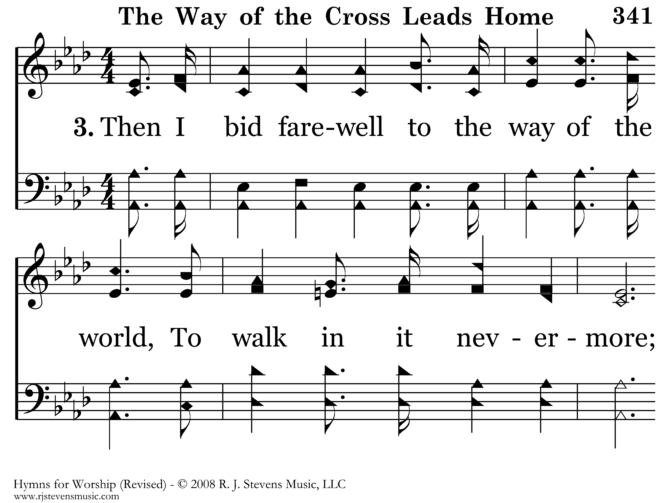
341 - The Way Of The Cross Leads Home - 3.1

Slide 108
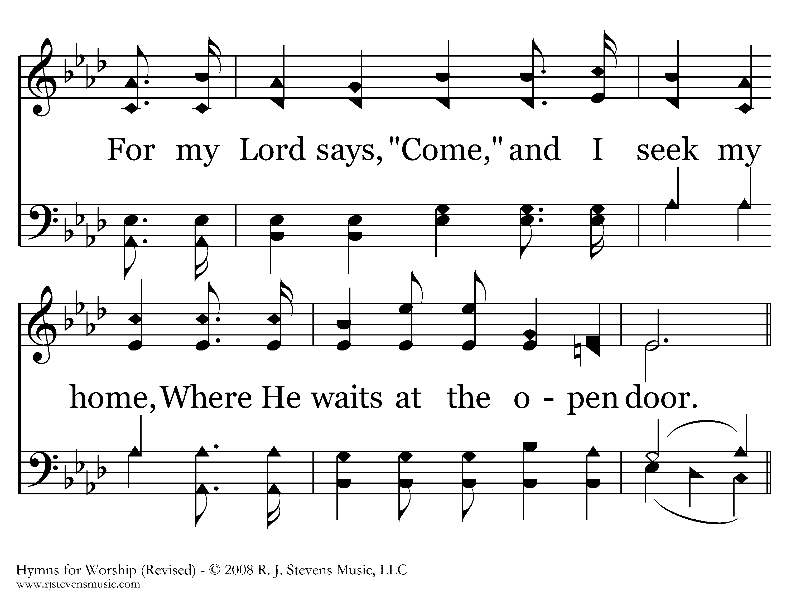
341 - The Way Of The Cross Leads Home - 3.2

Slide 109
341 - The Way Of The Cross Leads Home - C.1

Slide 110
341 - The Way Of The Cross Leads Home - C.2
End of Song

